Slide 1
MULTIDISCIPLINARY NATURE OF ENVIRONMENTAL STUDIES
B.A 1st Semester(BOYS SECTION)
PRESENTED by- Anuradha Roy Assistant Professor of NAMCE(B.Ed)

Slide 2
WHAT IS ENVIRONMENT?
Everything that surrounds and affects is living organisms is environment. The word ‘Environment’ is derived from the French word ‘ENVIRONMER’ which means ‘To encircle or surround’. All the biological and non-biological entities surrounding us are included in Environment.
According to C.C Park(1980)– ‘Environment refers to sum total of conditions which surround man at a given point in space and time’.
As per Environmental Protection Act(1986)- ‘Environment includes water, air and land and human beings , other living creatures, plants, micro-organisms and property’.
Environment is the sum total of all the external forces, influences and conditions, which affect the life, nature, behaviour and the growth, development and maturation of living organisms.
The environment provides resource which support life on the earth and which also help in the growth of a relationship of interchange between living organisms and the environment in which they live.

Slide 3
ASPECTS OF ENVIRONMENT
What is surrounded? – The answer refers to this question is living objects in general and man in particular.
By what surrounded? – The scope of the term environment has been changing and widening by the passage of time more so time more so with respect to human beings. In the primitive age, the environment of man consisted of only physical aspects of the planet earth that is land, air, and water as biological communities. As the time passed on man extended his environment through his social, economic and political functions.
Where surrounded?- It is the physical component of the plant earth, land, air water etc., that support and affect life in the biosphere.
Any external force, substance or condition which surrounds and affects the life of an organism in any way termed as an Environmental factor.

Slide 4
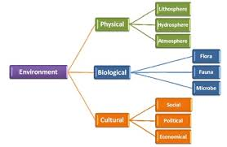
TYPES OF ENVIRONMENT

Slide 5
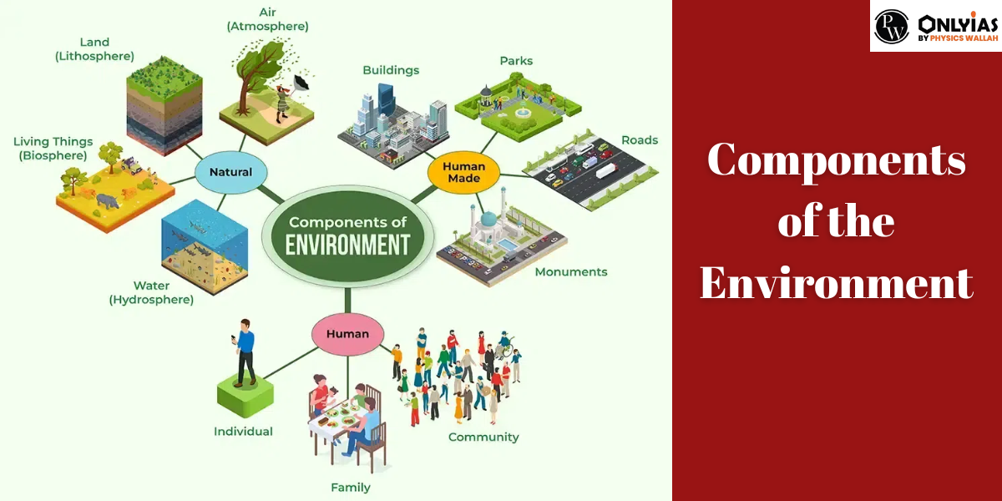

Slide 6
ENVIRONMENTAL STUDIES
Environmental study is a multidisciplinary field which systematically studies human interaction with the environment in the interests of solving complex problems. It is a broad field of study that includes the natural environment, built environments, social environments, organizational environments and the sets of relationships between them.
Environmental studies involves principles from the physical sciences, commerce/economics, the humanities, and social sciences to address complex contemporary environmental issues.

Slide 7
FEATURES OF ENVIRONMENTAL STUDIES
It is the study of a range of environments, from the bodies we live, so the physical structures, institutions and industries we build , to the politics, language and cultural practices we use to communicate and to the earth and its complex multitude of animals, flora and bio-physical elements and processes.
In environmental studies the social sciences, humanities art and natural sciences meet and inform each other.
The study incorporates theoretical approaches and disciplinary and interdisciplinary ideas to explore environment issues and options in their historical, comparative and current contexts, considering ecological, political and economic constraints and possibilities.
It encourages exploration of how theoretical and practical matters and intersect and how reflexive, rigorous, critical and creative thinking can inform interpretations and policies in the wider society.

Slide 8
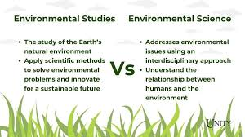
DIFFERENCE BETWEEN ENVIRONMENTAL STUDIES AND ENVIRONMENTAL SCIENCE

Slide 9
MULTIDISCIPLINARY NATURE OF ENVIRONMENTAL STUDIES
Environmental studies is a multidisciplinary study, as it uses the knowledge and methods of different disciplines or fields of study to understand and address the environment and its issues. Environmental studies is a multidisciplinary study, as it:
Combines the knowledge and methods of the natural sciences, the humanities, and the social sciences, to understand the physical, biological, social, and economic aspects and dimensions of the environment and its issues.
Incorporates the views and experiences of different disciplines or fields of study, such as environmental science, ethics, policy, law, education, communication, justice, history, sociology, psychology, economics, geography, anthropology, art, and more, to offer a diversity and richness of perspectives and insights on the environment and its issues.

Slide 10
MULTIDISCIPLINARY NATURE OF ENVIRONMENTAL STUDIES
Generates new and novel ideas and solutions, by combining and synthesizing the knowledge and methods of different disciplines or fields of study, to enhance the creativity and innovation in addressing the environment and its issues.
Facilitates the communication and exchange of information and resources, among different disciplines or fields of study, to foster the collaboration and cooperation in addressing the environment and its issues.
Environmental studies is a multidisciplinary study, as it provides a comprehensive and holistic understanding of the environment and its issues, and contributes to the environmental and sustainability protection and improvement

Slide 11
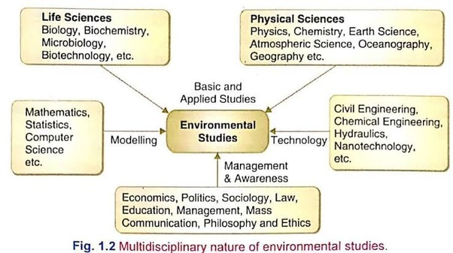

Slide 12
NEED FOR PUBLIC AWARENESS
As the earth's natural resources are rapidly dwindling and our environment is being increasingly degraded by human activities, it is evident that something needs to be done. It is not possible for the Government to perform all the necessary clean-up functions. Prevention of environmental degradation must become a part of all our lives. Just as prevention is better than cure for a disease, protecting our environment is economically more viable than cleaning it up once it is degraded or polluted. Individually we can reduce wastage of natural resources and we can act as watchdogs that inform the Government about resources or polluters that lead to pollution and degradation of the environment; only then will the polluter pay!

Slide 13
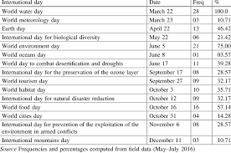
Mass media such as newspapers, radio and TV strongly influences , create public awareness. And reinforce public opinion. Politicians in a democracy always respond positively to a strong public - supported movement.Thus if you join a NGO that supports conservation of environmental assets,you might be able to influence politicians to make green policies.
Just understanding and making ourselves more aware of our environment and change the way in which we use every resource.We should shift from wasteful behaviour patterns to environmentally friendly practices , and analyse Old method ls from new perspectives.Only then will our lifestyles become more sustainable and support our environment.

Slide 14
THE ENVIRONMENT AND ITS STAKEHOLDERS
Environmental Scientists:
Ecologists:
Conservation Biologists:
Taxonomists:
Conservationists:
Environmentalists:
Traditional knowledge holders:
Socio-environmentalists:

Slide 15


