Slide 1
Meaning and concept of language across curriculum
Paper-4
Unit-i

Slide 2
Meaning of LAC
Language Across Curriculum is a modern concept that a foreign or second language should be taught out of the traditional language classroom by using contextual and content based language teaching methodologies throughout the school hours. Hence it demands that language learning should occur in language classroom as well as other subject classrooms

Slide 3

Concept of LAC

Slide 4


Slide 5


Need and significance of LAC

Slide 6

In case of the students

Slide 7


Slide 8


Slide 9


Slide 10


Slide 11


Slide 12


Slide 13
In case of the teacher

Slide 14
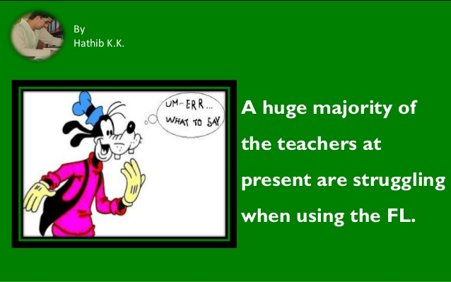
In the case of teachers

Slide 15


Slide 16
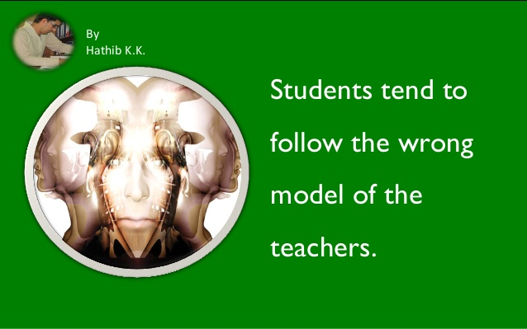

Slide 17
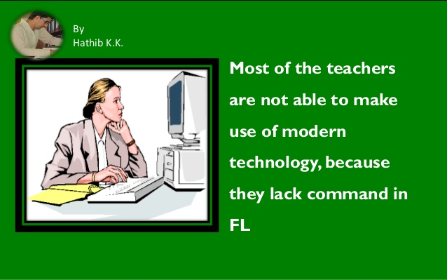

Slide 18


Slide 19


Slide 20


Slide 21


Slide 22


Slide 23


Slide 24
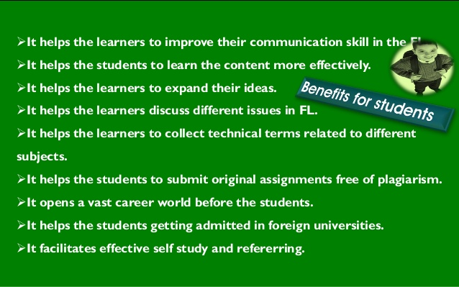

Benefits by LAC

Slide 25


Slide 26
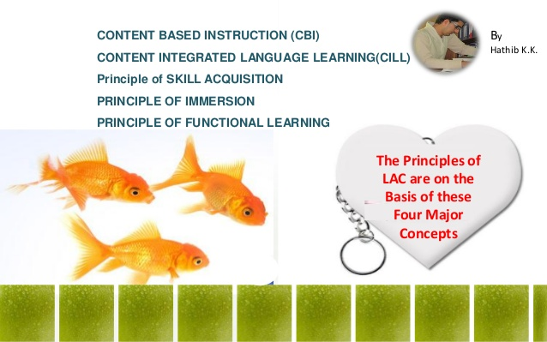

Slide 27
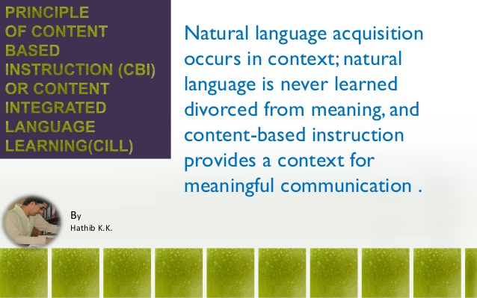

Slide 28
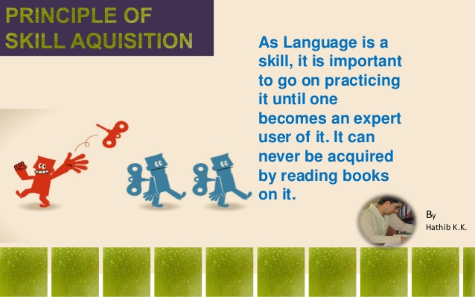

Slide 29


Slide 30
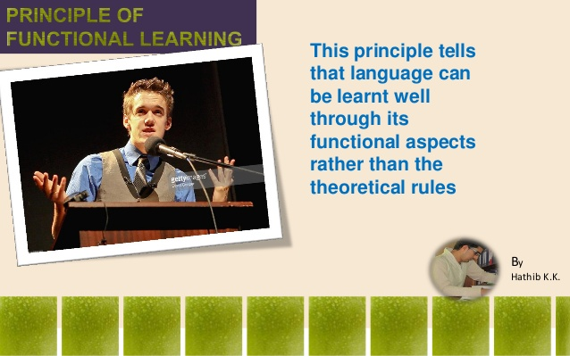

Slide 31


Slide 32
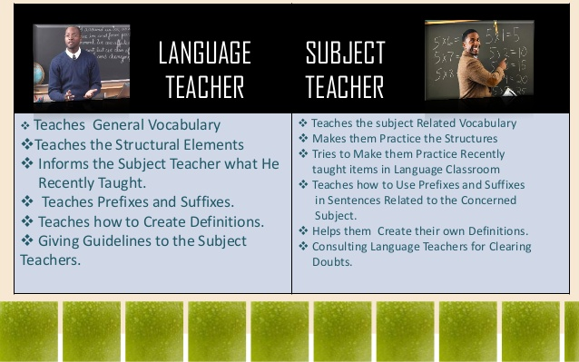

Slide 33
Thank You

