Slide 1
Meaning and concept of curriculum
P-09
Unit-I

Slide 2
Meaning and concept of curriculum
• The curriculum is the totality of experiences that the child gains through the multifarious activities in school .
• A well designed curriculum helps the learner in gaining knowledge, developing concepts and inculcating skills, attitudes, values and habits.

Slide 3
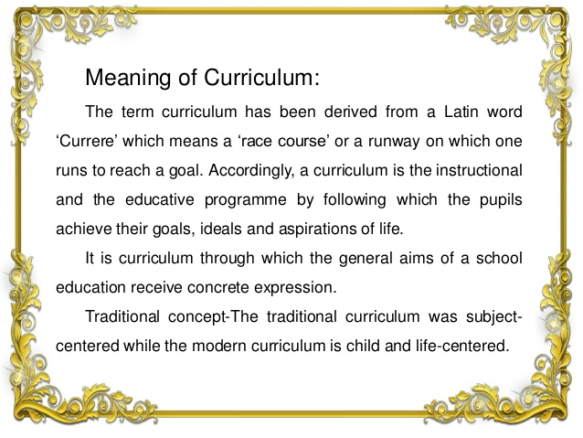

Slide 4
A curriculum is a plan of learning. it has a definite structure through which the vision of the planner can be translated into learning experiences of the child.
According to the modern concept of curriculum, it not only includes the academic subject but also the overall experience pupils receive
It not only includes the experiences that child receives through activities in classroom but also the experiences that child receives in laboratory, workshop, playground and in the numerous informal contacts between teacher and pupil.

Slide 5
Curriculum is a systematic arrangement of the sum total of selected learning experiences planned by a school for a defined group of students to attend the aim of a particular educational programme.
According to Coles, curriculum is the sum of all the activities, experiences and learning opportunities for which an institution takes responsibility deliberately or by default.

Slide 6
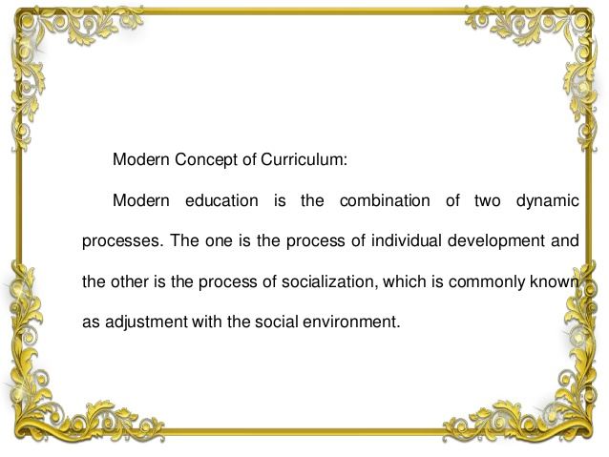

Slide 7
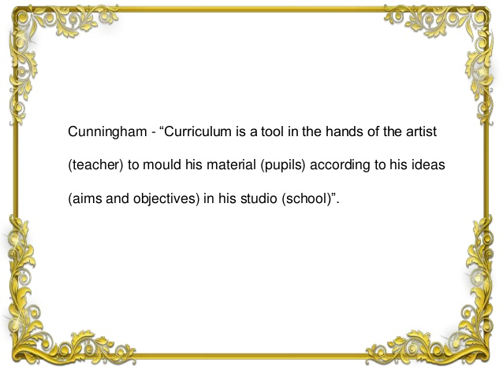

Slide 8
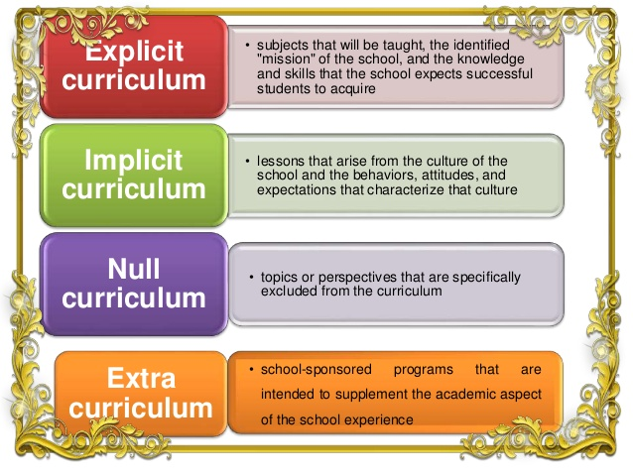

Slide 9
The concept of curriculum is an dynamic as changes that occur in society. In its narrow sense, curriculum is viewed merely as listing of subject to be taught in school. In a broader sense, it refers to the total learning experiences of individuals not only in school but in society as well.

Slide 10
The term curriculum refers to the lesson and academic content taught in a school or in the specific course or programme. In dictionaries, curriculum is offer defined as the courses offered by a school, but is rarely used in such a general sense in school.

Slide 11
Curriculum typically refers to the knowledge and skills students are expected to learn, which includes the learning standards or learning objectives they were expected to meet;
The units and lessons that teacher teach.
The assignments and project given to the students.
The books, materials, videos, presentation and readings used in a course;
Tests, assessments and other methods used to evaluate students learning.

Slide 12
A curriculum can be called plan for learning. Which contains assumptions about the purpose of education in our society. It also has a definite can be translated into learning experiences for the learners. Hence any curriculum comprises two major dimension:
A vision and
A structure

Slide 13
Sanskrit term of curriculum
The Sanskrit equivalent of the term ‘curriculum’ is ‘Pathyakram’
Dewal (2004) has explained that the term mean the sequence of course of study including the content and its processes.
According to Dewal(2004): “Pathyakram encompasses the content, a sequence of study pertinent of the stage of Education”

Slide 14
Sanskrit meaning of the term curriculum
Dewal opinion
A course of study
A sequence of the course depending on the stage of Education
The content and processes arranged in a definite hierarchy
The sequence of the study begins with process of understanding, to acquire and to think or to reflect.

Slide 15
Curriculum is..........
That which is taught in schools.
A set of subjects.
Content.
A program of studies.
A sequence of courses.
A set of performance objectives.
A course of study.
Is everything that goes on within the school, including extra-class activity, guidance, and interpersonal relationships.
Everything that is planned by school personnel.
A series of experiences undergone by learners in a school.
That which an individual learner experiences as a result of schooling.

Slide 16
Thank You

