Slide 1
DEVELOPMENTAL PSYCHOLOGY-MEANING,NEED AND IMPORTANCE
PREPARED BY-
HALIMA ABDUL MATIN

Slide 2
Our Approach To Developmental Psychology
Understanding Developmental Psychology
Understanding psychology
Understanding development

Slide 3
Understanding of Psychology
LATIN WORDS
“Psyche”
Meaning soul/mind
Etymological meaning of Psychology is study of soul or mind
“Logos”
Meaning “study of”

Slide 4
Understanding Development
Development
More or less predictable changes in behavior associated with increasing age.

Slide 5

Concept of Developmental Psychology
A field of psychology that focuses on development across the life span is known as Developmental Psychology.
It examines the physical, mental and social changes that occurs throughout the life cycle.
It is the scientific study of biological , social , and personal development across the life span.

Slide 6

Concept of Developmental Psychology
Developmental psychology is an important branch of psychology.
It is a scientific approach which aims to explain growth , change and consistency through the lifespan .
It studies human beings from womb to tomb.
It also studies how and why human being changes over their whole life.

Slide 7

It covers the physical and perceptual development after birth , rapid growth during early stages of life , social, moral, emotional and cognitive development during childhood.
It also covers the way children think about the world and changes over time.

Slide 8
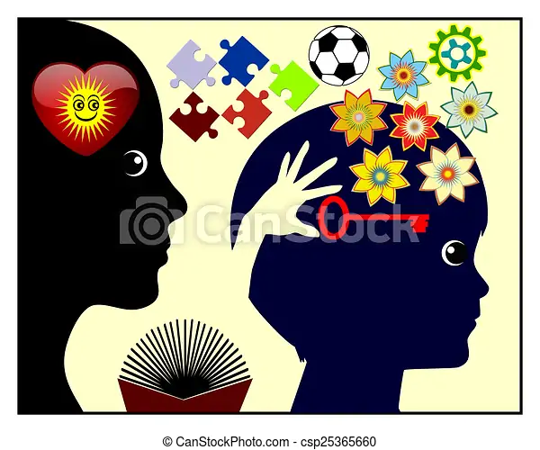
Need and Importance of Studying Developmental Psychology
To identify innate talents among individuals.
To examine if a child has some developmental disability.
To understand and recognize individual difference in the course of human development.

Slide 9
Need and Importance of Studying Developmental Psychology
To understand the role of nature and nurture in development.
To study how different skills are acquired and how help can be provided in this regard.
To understand the behavior of man.
To understand the mental health of individual

Slide 10

Need and Importance of studying Developmental Psychology
Knowledge of developmental psychology is important for better counseling and guidance.
Knowledge of developmental psychology is also important for understanding the underlying causes of crime and delinquency among individuals.

Slide 11
Conclusion
Developmental psychology is a special field of psychology which studies human behavior ; helps in identifying individual differences . It also helps in preventing mental illness. Moreover developmental psychology can help to understand the psycho-physical causes underlying mental illness and suggest measures for proper adjustment and development.

Slide 12


