Slide 1
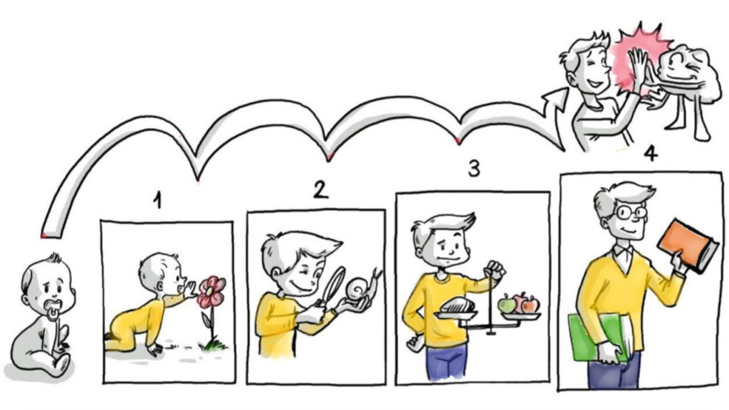
Principles of Development

Slide 2
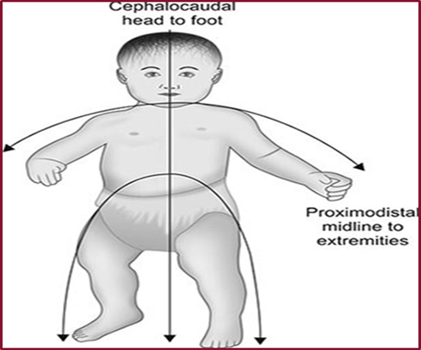
The Cephalocaudal principle:
It describes that development proceeds from the head to foot.
As per this principle, children gain control of the head first, then the arms, and then the legs.

Slide 3

The Proximodistal principle:
According to this principle, development proceeds from the Centre of the body to outward.
That is why the spinal cord of the body develops before the outer parts of the body are developed.

Slide 4
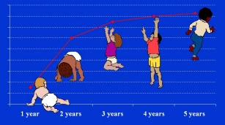
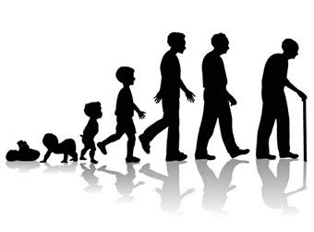
The Principle of continuity:
Human development is a never ending continuous process of progressive changes.
The process continues from “womb to tomb”.

Slide 5

The principle of individual difference:
Every individual is different from each other in terms of their rates of growth and development.

Slide 6


The principle of interaction between heredity and environment:
The process of human growth and development is determined by genetic and environmental factors.
The genetic and environmental factors are so intermingled to give a definite pattern of growth and development that is become impossible to assess their influences separately.

Slide 7

Principle of maturation and learning
Development is always associated with maturation and learning.
Maturity refers to the ability to function at a higher level.
It is also known as readiness.
Children are able to perform certain types of activities by learning even after maturation.
For example, writing is a complex skill which requires readiness of different parts of the body such as eyes, hands, fingers and the thumb.
Maturation or readiness is necessary for learning and learning helps further development.

Slide 8

Development proceeds from general to specific:
The early responses of the babies are very general.
In course of time these early responses are replaced with specific ones.
For example in the early stages of language development, a child may use a particular word for a type of food but on increase his or her vocabulary he or she learns to use correct specific words.

Slide 9

The principle of uniform patterns:
Development follows a uniform pattern or sequence.
This uniformity is predictable in physical, emotional and cognitive areas of children.

Slide 10
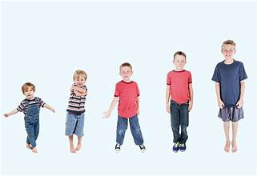
Development is predictable :
The child grows and develops in a particular sequence though different stages which are predictable.
Sometimes a child may skip a minor stage; for example, a child may stand and walk a few steps without learning to crawl.
But all children pass through the major stages of development.

Slide 11

Different parts of the body develop at different rates:
The development of the different parts of the body is not uniform.
For example physical development is very rapid in infancy, but it slows down considerably during middle childhood.
Growth is again significant during pre- adolescence and adolescence periods. Maximum growth is attained by the age of 18-20 years.
Development is not uniform in all parts the body for example, brain attains its maximum size around the age of nine.
During early adolescence, limbs develop at a very rapid rate.

Slide 12
Conclusion
At the end, we can say that the growth and development plays most important role in an individual’s life.
Everyone specially the teachers must understand the concept and principles as well the stages of growth and development so that they can teach the students according to their age, Interest, skills and needs.

Slide 13
Thank You So Much for Listening.

