Slide 1
Trial And Error Method

Slide 2
Edward Lee Thorndike’s Theory of Learning
Learning is the result of associations between stimuli and response. (S-R bond).
Theory of Connectionism.
Trial and error means committing errors while trying to achieve a goal or solving a problem.

Slide 3
Edward Lee Thorndike
American Psychologist.
Father of Educational Psychology.
Prominently known for "Trial and Error Theory“
Subject-Cat.
Stimulus- Fish.
Motivation- Smell.
Drive-Hunger.

Slide 4
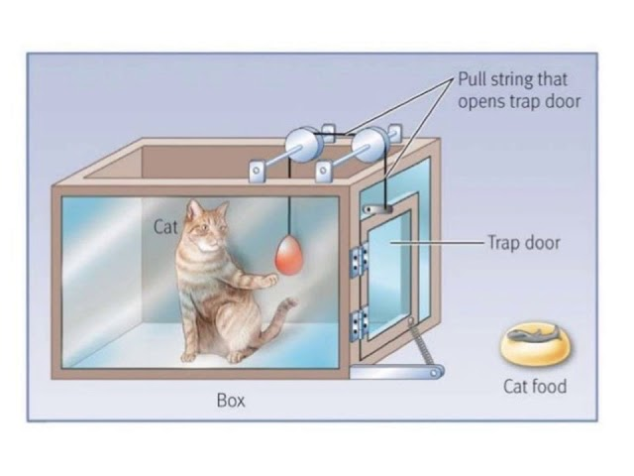
Trial and Error Method

Slide 5
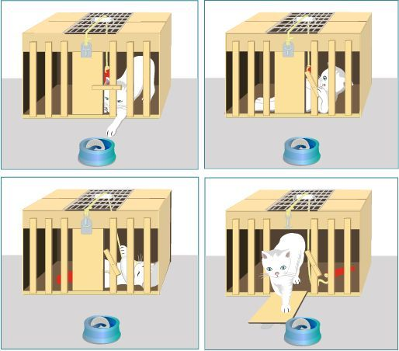
Experiment

Slide 6
Laws of Learning
Thorndike classified two different categories of laws of learning.
Primary Laws of Learning.
Secondary/Subordinate Laws of Learning.

Slide 7
Primary Laws of Leaning
Law Of Readiness.
Law of Exercise.
Law of Effect .

Slide 8
Secondary/Subordinate Laws Of Learning
Law of Primacy
Law of Recency.
Law of Intensity and Stimulus.
Law of Multiple Response.
Law of Set or Attitude.
Law of Analogy and Assimilation.
Law of Associative Shifting.
Law of Partial Activity.

Slide 9
Thank You

