Slide 1
Unit-IV
Graphical Representation of data
Pie diagram

Slide 2
2. Pie diagram

Slide 3
2. Pie diagram:
Pie diagram is the graphical representation of data which is represented through the section or portion of a circle.
This graph looks like a pie, so it is popularly known as Pie Diagram.
It is also known as circle diagram.

Slide 4
We have to follow some steps in constructing a pie diagram:
Step-1: First, we have to draw a circle. As we know that the surface area of a circle is 2 pie (π) or 360°.
Step-2: Secondly, the given data is to prepared in the form of degree under different heads.

Slide 5
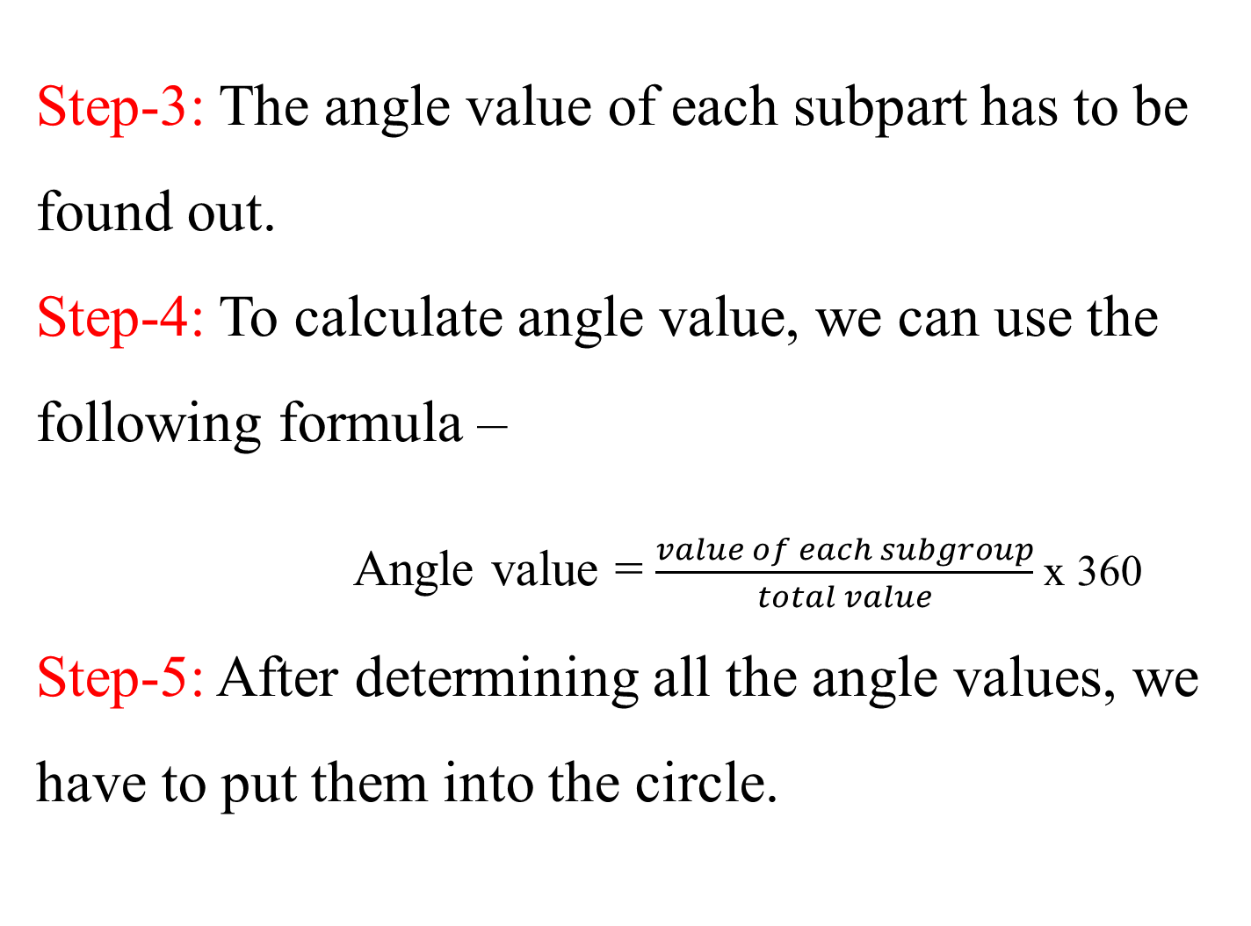
Step-3: The angle value of each subpart has to be found out.
Step-4: To calculate angle value, we can use the following formula –
Angle value = $\frac{value of each subgroup}{total value}$x 360
Step-5: After determining all the angle values, we have to put them into the circle.

Slide 6
Example
Area of work experience | No. of students
Photography | 6
Clay modeling | 30
Kitchen gardening | 48
Doll-making | 12
Book- binding | 24
 | Total=120

Slide 7
Area of work experience | No. of students | Angle of the circle
Photography | 6 | X 360 =
Clay modeling | 30 | X 360 =
Kitchen gardening | 48 | X 360 =
Doll-making | 12 | X 360 =
Book- binding | 24 | X 360 =
Total= | 120 | 360

Slide 9
Thank you

