Slide 1
Unit-IV
Graphical Representation of data
Frequency polygon

Slide 2
Frequency Polygon:
A frequency polygon is a graphical representation of frequency distribution of a dataset.
A frequency polygon is basically a line graph of frequency distribution.
It is used to visualize the shape and spread of continuous data.

Slide 3
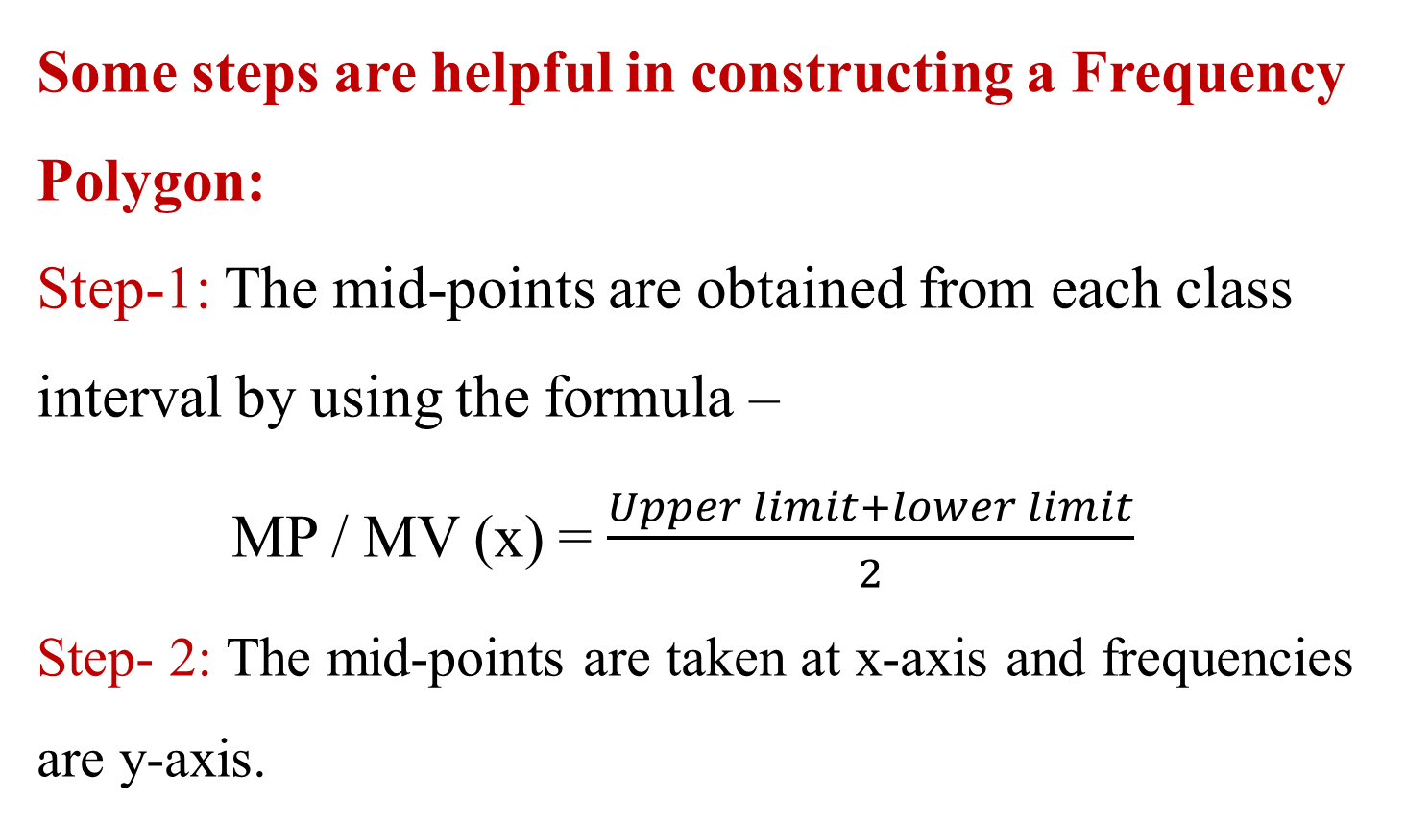
Some steps are helpful in constructing a Frequency Polygon:
Step-1: The mid-points are obtained from each class interval by using the formula –
MP / MV (x) = $\frac{Upper limit+lower limit}{2}$
Step- 2: The mid-points are taken at x-axis and frequencies are y-axis.

Slide 4
Frequency Polygon:
Step – 3: The various points are jointed by the scale to get the Frequency Polygon.
Step – 4: To take two extra class intervals one below and one above the class interval and their mid-point also with 0 (zero) frequency.

Slide 5
Example:
Draw a frequency polygon from the given data.
Sl. No. | Class Interval | Frequency
1 | 20 – 24 | 3
2 | 25 – 29 | 5
3 | 30 – 34 | 9
4 | 35 – 39 | 13
5 | 40 – 44 | 16
6 | 45 – 49 | 8
7 | 50 -54 | 4
8 | 55 - 59 | 2

Slide 6
Sl. No. | Class Interval | Mid-value | Frequency
1 | 20 – 24 | 22 | 3
2 | 25 – 29 | 27 | 5
3 | 30 – 34 | 32 | 9
4 | 35 – 39 | 37 | 13
5 | 40 – 44 | 42 | 16
6 | 45 – 49 | 47 | 8
7 | 50 - 54 | 52 | 4
8 | 55 - 59 | 57 | 2

Slide 7
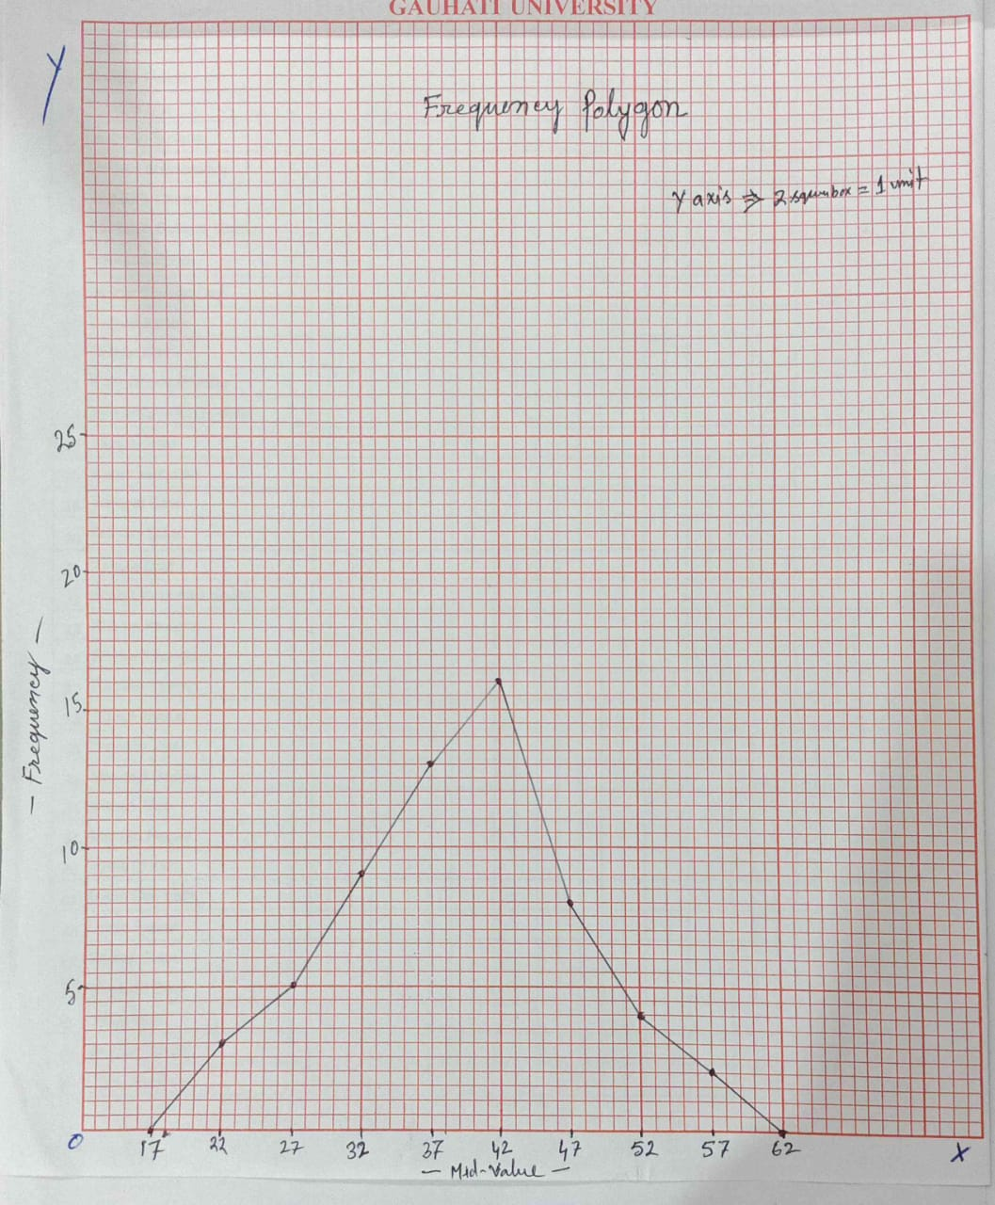

Slide 8
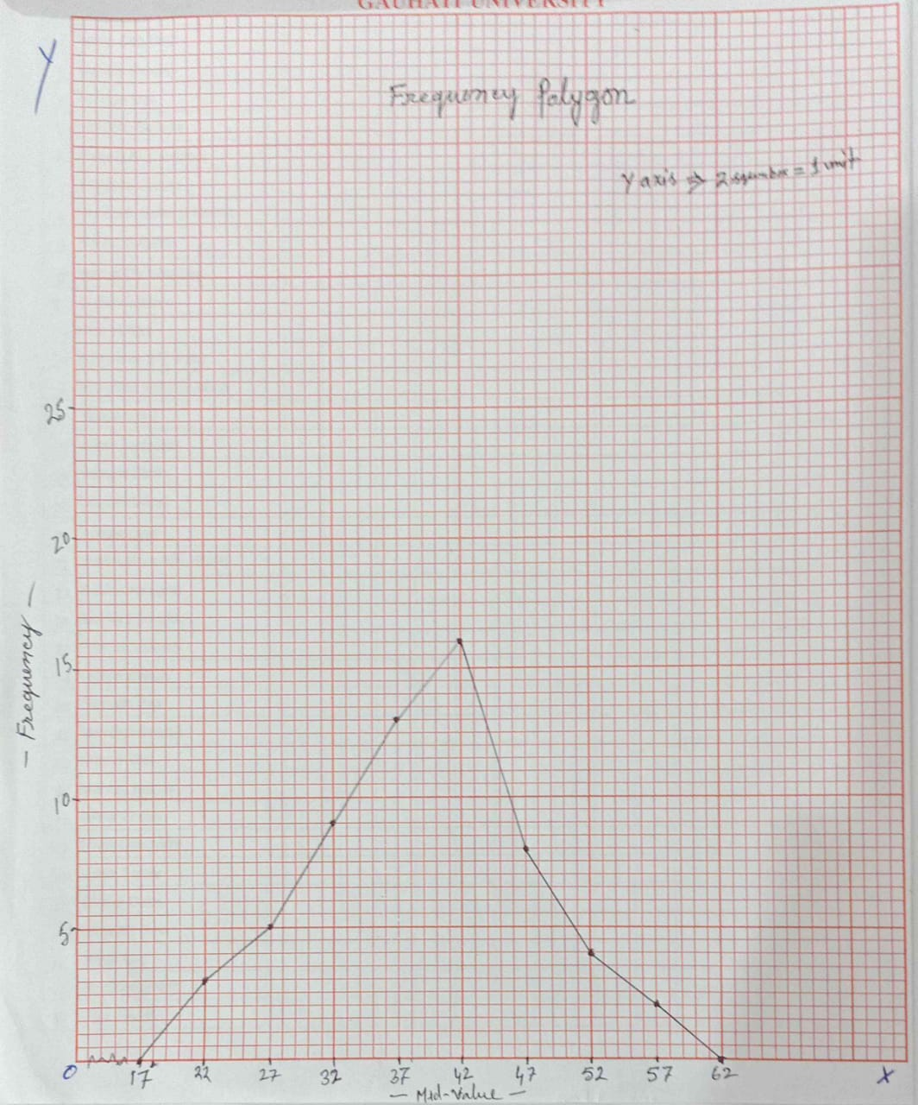

Slide 9
Example: 2
Draw a frequency polygon from the given data.
Class Interval | Frequency
10 – 14 | 2
15 – 19 | 5
20 – 24 | 7
25 – 29 | 8
30 – 34 | 13
35 – 39 | 11
40 – 44 | 7
45 – 49 | 4
50 – 54 | 3

