Slide 1
Paper- 03
Unit- V

Slide 2
Classroom management
Meaning and Strategies-

Slide 3
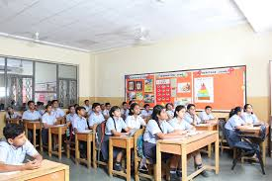
What is Classroom?

Slide 4
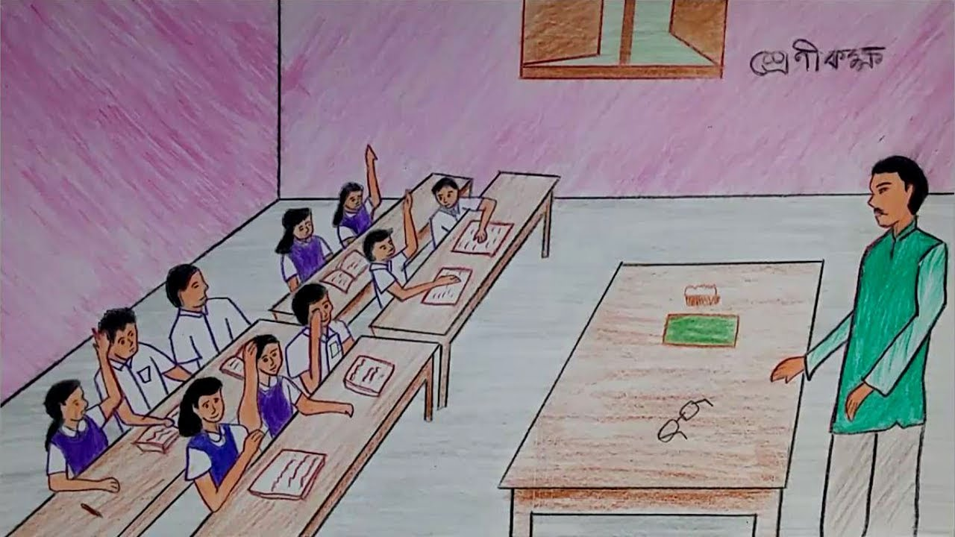
Classroom is a place where teachers and students gather for the purpose of learning. The teacher presents the lesson, and the students absorb the material.
A Room where everyone is involve with good attitudes and behaviors, and a willingness to learn.

Slide 5

What is Management?

Slide 6
Management:
Management is a process of planning, decision making, organizing, leading, motivating and controlling the human resources to reach its goals in an effective manner.

Slide 7
Classroom Management

Slide 8
Classroom Management:
Classroom management is simply the techniques to control in the classroom environment.
Classroom management means the wide variety of skills and techniques that teachers use to ensure that their classroom runs smoothly, without disruptive behavior from students.

Slide 9
Objectives of Classroom Management:
Developing good interpersonal relationship between the teacher and the student.
Maintaining discipline in the classroom.
Encouraging self learning habit on the part of the students.
Providing knowledge in a better way.
Facilitating all round development of the students.

Slide 10
Classroom Management Strategies:
Successful classroom management strategies creates a positive learning environment for students.

Slide 11
Maintain Positive Attitude:
Teach each lesson with a positive mind frame.
A negative approach towards your students can provide negative results.
Be strict, but be positive.

Slide 12
2. Use Some Signals to Get Attention:
Teachers can use any word, signal or sound to grab student’s attention during class.

Slide 13
3. Make Changes in Seating Arrangement:
Changes in the seating design can bring in the discipline in your class.
It is the cheapest form of managing our class.
Make sure to seat the children where their attention is directed towards you.

Slide 14
4. Update Lesson Plan:
Teacher should also learn the skills need to plan and teach lessons.
Updated lessons and course structure is essential in the process of teaching and learning.
A new teacher must be ready to spend the necessary time developing interesting lessons.

Slide 15
5. Give and Take Respect:
To be respected by your students you should also respect them.
And also, have the general talk with students.
Know what the student does at home.

Slide 16
6. Get students Involved in Extracurricular Activities:
To make classroom a better learning place teacher can arrange some extracurricular activities.
Ask every student to participate in the activities .
This will also help the students to realize that teacher are there to encourage them.

Slide 17
7. Compliment positive Behaviors:
Instead of correcting a student’s negative attention, ignore his behavior and praise the students.

Slide 18
8. Silence is the Right Tool:
Shouting at the unruly students will be of no use.
It is ideal to use a calm and quiet voice.
By remaining silent, students will realize the values of teacher conversation.

Slide 19
9. Balance Friendliness and Position:
A teacher maintains balance in the classroom.
Be friendly to your students and advise them in difficult situations.
But teacher always remember that they are the authoritative figure in the classroom.

Slide 20
10. Punish the Right Candidate:
It would never be fair to punish an entire class.
Choose the right pupils who are creating the situation.
Punishing the class as a group only provokes further conflict.

Slide 21
11. Use Simple Language:
The classroom is not the place for teachers to exhibit their language fluency and expertise.
Talk to students in a very simple language so that they will clearly understand the teacher’s instructions.

Slide 22


