Slide 1
Subject specific knowledge
P-04
Unit-II

Slide 2
Subject specific knowledge
The term content knowledge refers to the body of knowledge and information that teacher teach and that students are expected to learn in a given subject or content area, such as English language arts, mathematics, science, and social studies.

Slide 3
Subject specific competence
Teaching has never been an easy chore. It requires passion, pedagogy, and professionalism. It also requires continual change. Instructional strategies must evolve to help students with varying abilities and learning styles acquire and apply knowledge. Most teachers do a pretty good job of keeping up with improved pedagogies.
However, a national conversation that has been ongoing over the past three decades or so is focused on how much subject specific knowledge teachers should have. The thought is the more teachers know about a subject, the better they will be at teaching it.

Slide 4
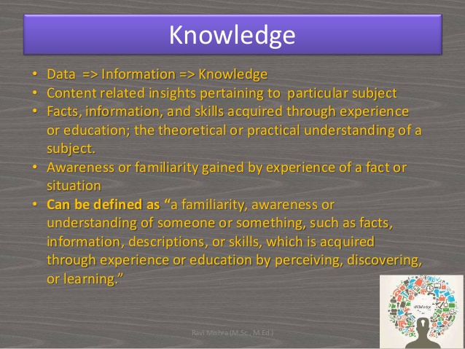
Subject specific competence

Slide 5
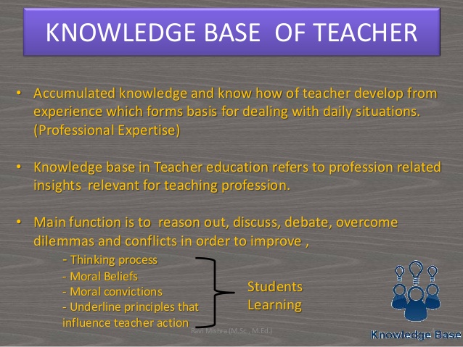

Slide 6
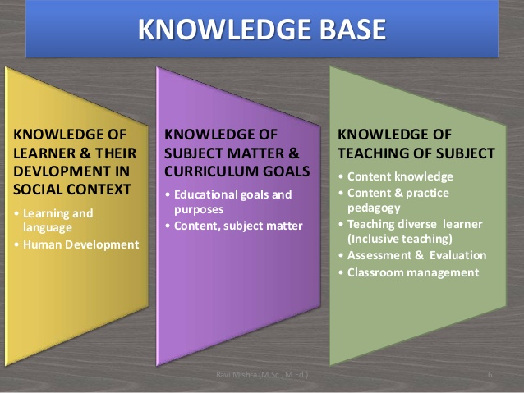

Slide 7
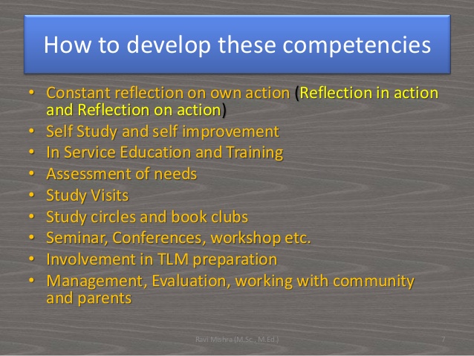

Slide 8
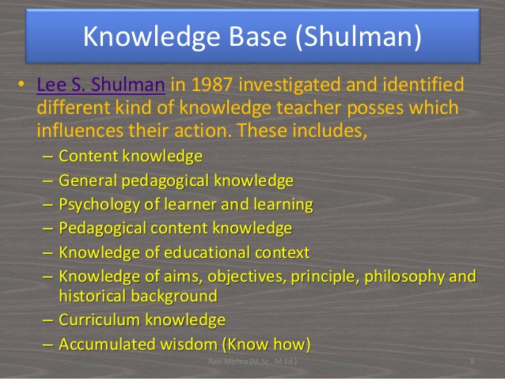

Slide 9
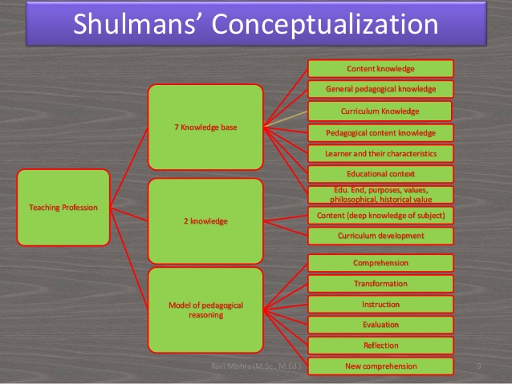

Slide 10
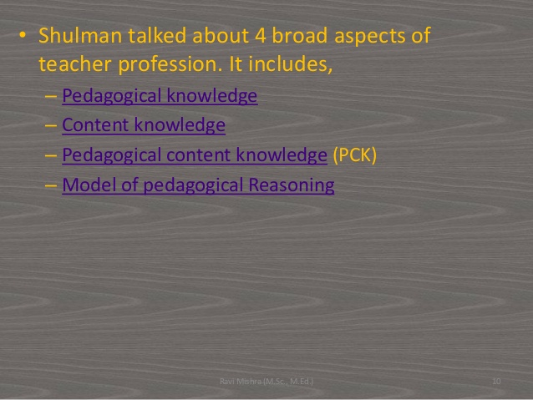

Slide 11
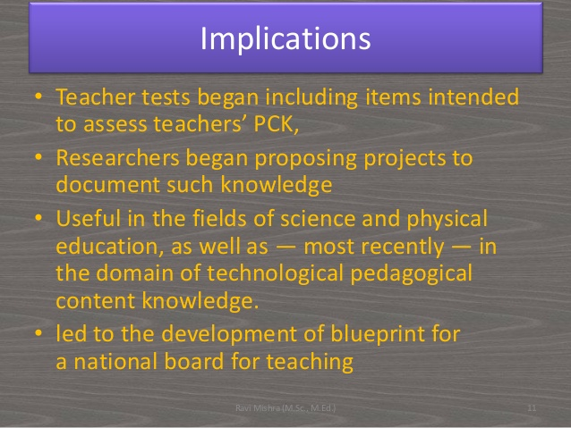

Slide 12
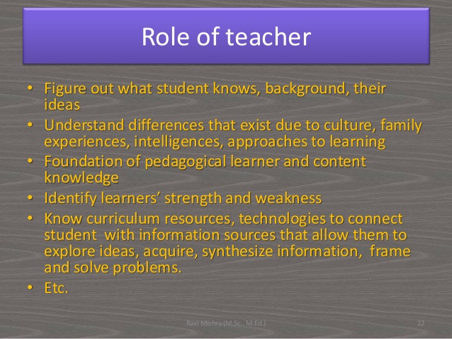

Slide 13
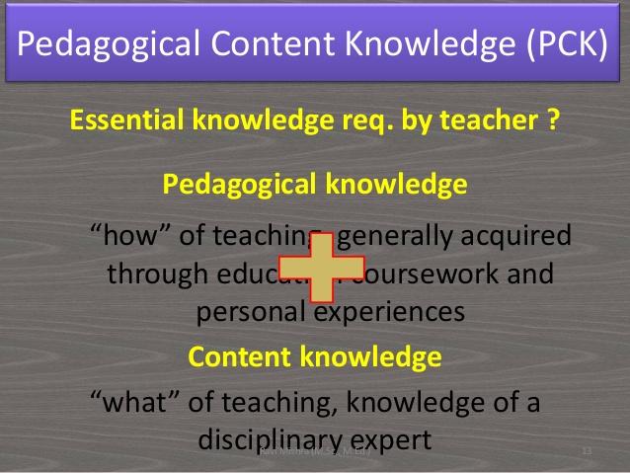

Slide 14
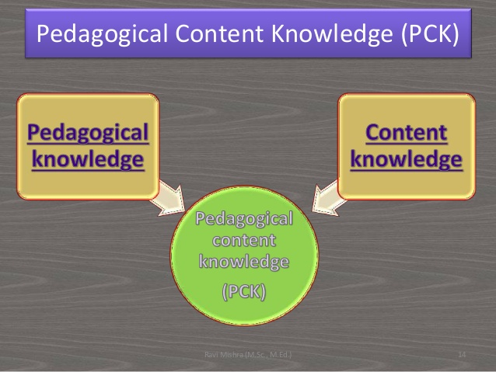

Slide 15
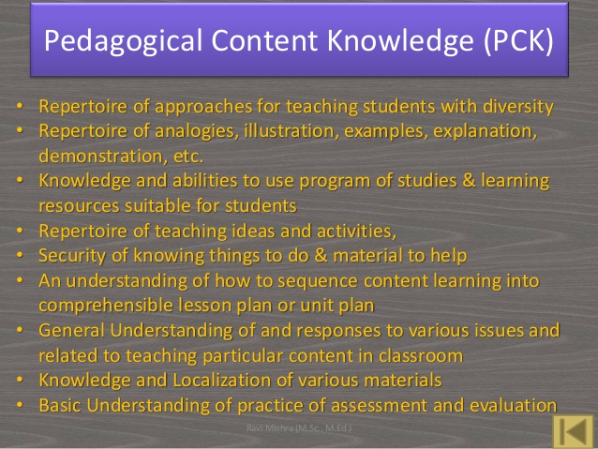

Slide 16
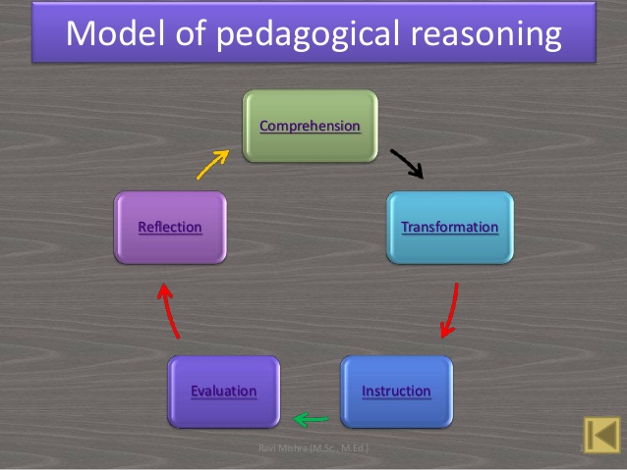

Slide 17
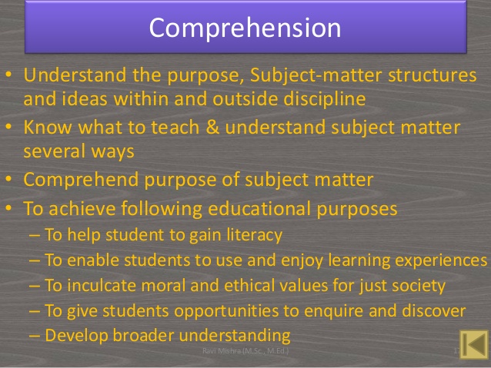

Slide 18
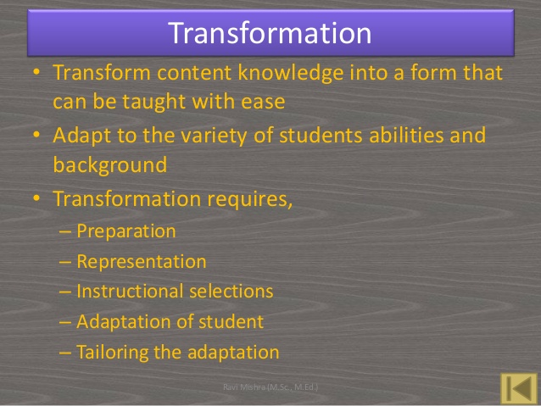

Slide 19
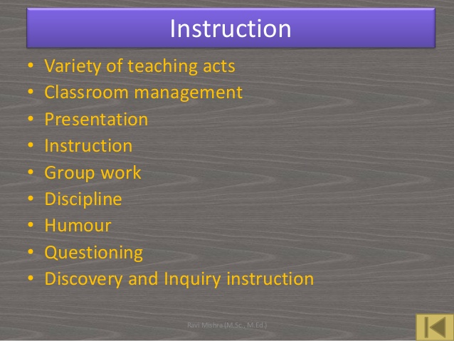

Slide 20
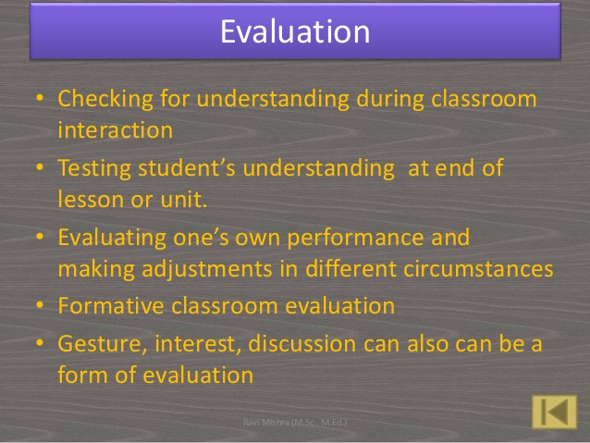

Slide 21


Slide 22
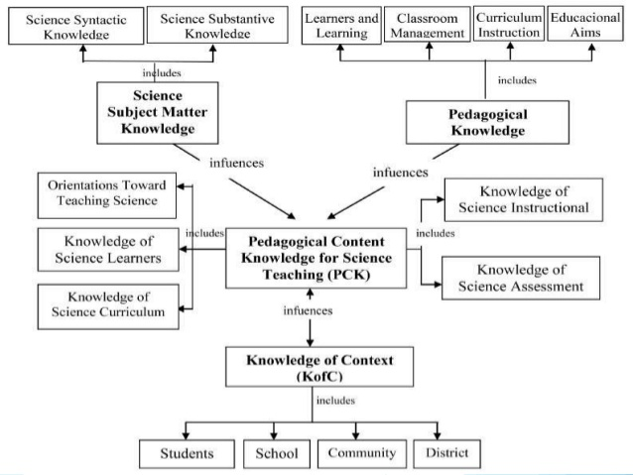

Slide 23


