Slide 1

One Act Play
The plays which has a single act, single plot that is called one act play.

Slide 2



Slide 3
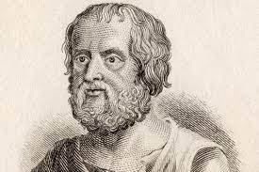
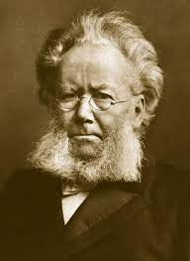
Origin development of the one act play:
The play Cyclopes written by Euripides is considered as the first one act play.
Euripides Henrik Ibsen
Norwegian playwright
Ancient Greek tragedian

Slide 4
Curtain raiser:
Characteristics:
This types of plays has only one act .
This types of plays has a single set design.
The story develops in a very simple and fast .
The number of character is less.
Story formation from 15 minutes to 1 hour.
Formation of the dialogue is very simple.

Slide 5
Formation of the story:
Initial Action
Rising Action
Climax, Turning Point
Falling Action
Conclusion
Exposition = Introduction part.
Conflict= rising of the story.
Climax= extreme point of the story.
Denouement= the final stage of the play.

Slide 6
Some important dramatist and their plays:
Edward Albee : Zoo story, The Goat, or Who Is Sylvia? (2002)
Samuel Beckett : Krapp's Last Tape (1958)
Anton Chekhov : A Marriage Proposal (1890)
Joseph Heller : Clevinger's Trial (1973)
Israel Horovitz : Line (1974)
Eugène Ionesco : The Bald Soprano (1950)
Arthur Miller : A Memory of Two Mondays (1955)
August Strindberg : Pariah (1889), Motherly Love (1892), and The First Warning (1892)
Thornton Wilder : The Long Christmas Dinner (1931)
Cormac McCarthy : The Sunset Limited (2006)
Jean-Paul Sartre : No Exit (1944)

