Slide 1
Theory of Knowledge
Pramata: ( The Knower)
Prameya: (The Knowables)
Pramana: ( The Process of knowing)
Pramiti: (Knowing process by Pramana)

Slide 2
Pramanas
Valid Source | Invalid Source
Pratyaksha: (Perception) | Arthapatti: (Implication)
Anumana: (Inference)
Upamana: (Comparison) | Anupalabdhi: (Non-Apprehension)
Shabda: (Verbal Testimony)

Slide 3
Pratyaksha
Nirvikalpa (Indeterminate)
Savikalpa (Determinate)

Slide 4
Two kinds of Pratyaksha
Laukika (Ordinary) |  | Alaukika(Extra Ordinary)
External | Internal | Samanya Lakshna Gyan Lakshna Yogaj (Meditation)
1.Eyes 2.Nose 3.Ears 4.Skin 5. Tongue | Inner Sense

Slide 5

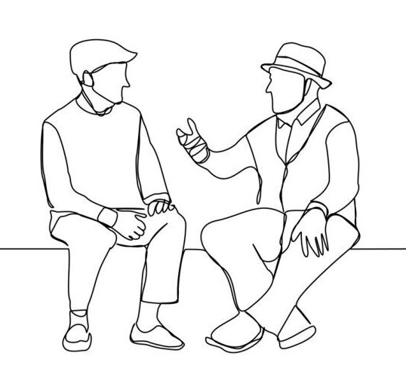
Anumana
Anumana is a second kind of knowledge .
Svartha | Paratha

