Slide 1
Curriculum design models
B.Ed. 2nd year
Paper-09

Slide 2
The concept of Curriculum design refers to the arrangement of elements of Curriculum into a Holistic plan here are some of the models of Curriculum design to make this Complex activity understandable and manageable.

Slide 3
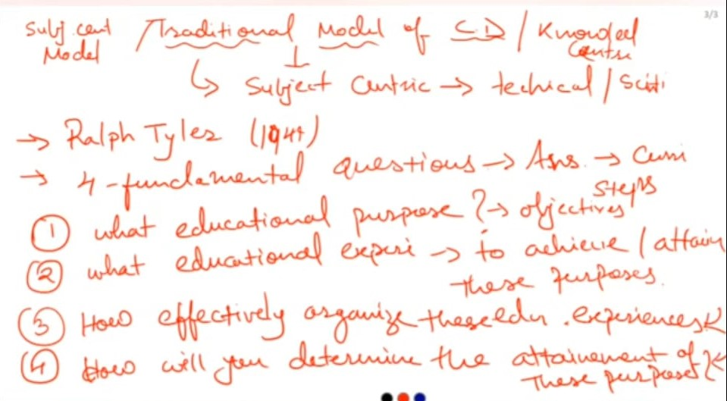

Slide 4
Traditional model/ Tyler’s Model
Tyler’s model is that it was one of the first models and it consists of four steps.
a. Determine the school’s purposes
b. Identify educational experiences related to purpose
c. Organize the experiences
d. Evaluate the purposes

Slide 5
Determine the school’s purposes
It starts with determining the objectives of the school or class. All objectives need to be consistent with the philosophy of the school and this is often neglected in curriculum development. For example, a school that is developing an English curriculum may create an objective that students will write essays. This would be one of many objectives within the curriculum.

Slide 6
Identify educational experiences related to purpose
Next is developing learning experiences. For example, if students need to meet the objective of writing an essay. The learning experience might be a demonstration by the teacher of writing an essay. The students than might practice writing essays. The experience (essay demonstration and writing) is consistent with the objective (Student will write an essay).

Slide 7
Organize the experiences
Next is organizing the experiences. Should the teacher demonstrate first or should the students learn by writing immediately? Either way could work and preference is determined by the philosophy of the teacher and the needs of the students. The point is that the teacher needs to determine a logical order of experiences for the students.

Slide 8
Evaluate the purposes
After this, evaluation of the objectives follows. Now the teacher assesses the students’ ability to write an essay. There are many ways to do this. For example, the teacher could have the students write an essay without assistance. If they can do this, it is evidence that the students have achieved the objective of the lesson.

Slide 9
This was given by Tyler in 1949 in his book “Basic principles of Curriculum and instruction”
This is one of the most widely used curricula throughout the world.
It has a subject centered orientation.
Set of experts pre-determine subject matter that should be mastered by students in this curriculum model.
The curriculum is structured around the content unit and the sequence of what is taught follows the logic of the subject matter.

Slide 10
It refers to School as the controller of power in deciding what is taught.
According to Tyler knowledge and skills should be taught in a sequence over time. This approach is called the spiral approach in which learners returns to topic in more complexity over time as they progress through the school.
In this model, students are given a set of skills or procedures that they have to master in a reasonable instructional cycle.

Slide 11
Advantages
1. It is easy to adapt to various methods of teaching.
2. It is easier to test scores in this curriculum because it uses traditional testing methods.
3. This method is cost-effective and does not require many resources.

Slide 12
Disadvantages
1. It lacks the integration of various subjects.
2. It focuses on one particular subject without the students being able to understand how one subject implement another.
3. It includes passivity and authority and lacks scope for creativity and innovation.

Slide 13
Taba Model
Hilda Taba advocated that those who use curriculum should be the curriculum designers as well. She believed that teachers should create specific teaching-learning situations for their students. They should adopt an inductive approach to teaching i.e. from - specific to general rather than the traditional deductive approach, starting from general to specifics.

Slide 14
Tabs's grassroots model has seven steps as listed below, advocating a major role for teachers. These are -
Diagnosis of needs - Identify needs of the students for whom curriculum is to be planned.
Formulation of Objectives - Specify the objectives by which needs will be fulfilled.
Selection of Content - Select subject matter based on objectives and determine validity of the chosen content.
Organization of content - Arrange the content in a particular sequence keeping in mind the maturity of learners, academic achievement, interests etc.

Slide 15
Selection of learning experiences - Facilitate interaction of learners with content through appropriate instructional methodology.
Organization of learning activities - The learning activities be organized in a sequence depending both on content sequence and learner characteristics.
Evaluation - To assess the achievement of learning objectives, evaluation procedures need to be devised.

Slide 16
Difference between Taba and Tyler’s Model:
Taba’ Model | Tyler’s Model
inductive | deductive
It is from teacher’s point of view as it believes that teacher’s are aware of the student’s needs and hence teachers should be the one to develop the curriculum and practice it. | It is from administrator’s point of view and believes that administrators should design the curriculum and teachers should implement it.
Her curriculum design doesn’t start with formulation of objectives and believes that it should start with studying the demand of the particular society. | It lays importance on aims, evaluation and control.

Slide 17
Galen Saylor and William Alexander (1974)
They viewed curriculum development as consisting of four steps.
1. Goals, Objectives and Domains: It begins by specifying the major educational goals and specific objectives. Example, personal development, human relations, continued learning skills and specialization.
2. Curriculum Designing: In this stage decision is made on the appropriate learning opportunities for each domain and how and when these opportunities will be provided.

Slide 18
3. Curriculum Implementation: Implementation of the designs is done by teachers.
4. Evaluation: Finally, curriculum planner and teachers engage in evaluation. The model proposed that evaluation should be comprehensive using a variety of evaluation techniques. Through the evaluation process, curriculum planner and developers can determine whether or nor the goals of the school and the objectives of instruction have been met.

Slide 20
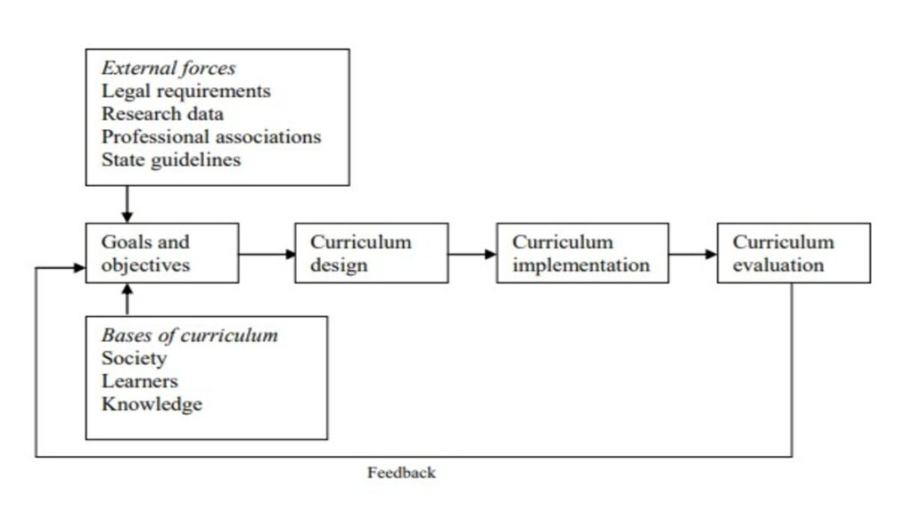

Slide 21
Selection of Curriculum Goals and Objectives
According to this model, curriculum designers should start by outlining the main educational objectives they want to achieve. They recommend the use of the following four curriculum domains, with each major goal representing one.
Personal Development
Social Competences
Continued Learning skills
Specialization

Slide 22
The selection of educational goals and objectives is influenced by
External forces, including legal requirements, research data, professional associations, and state guidelines, and
Bases of curriculum, such as society, learners, and knowledge.

Slide 23
Thank you

