Slide 1
Principles of curriculum construction
Unit-III
Paper-09

Slide 2
In curriculum development, we think about the type of learning experiences to be given to a child at various age and grade levels. It needs systematic and sequential planning to widen the sphere of the learning experience at each level by keeping in view the principles of integration and correlation.

Slide 3
The curriculum is usually concerned with two questions
What should we teach? What should be the content of education?
How should we organize it and how should we teach?
To answer these questions, we should now discuss the principles of curriculum construction.

Slide 4
Suitability to the age and mental level of the children
What is to be given to the children in the form of learning experiences at a particular age and grade level should suit their age and mental development
The capacity for understanding, how children grow with age. The content of the study in any subject should be formed to suit their mental ability.

Slide 5
According to the specific interests of students
Children will be able to learn better in fields where they have special tastes and inclination of the mind.
It is also found that at different stages of age groups, children have different interest patterns.
Interests of children also change according to circumstances and situations.
Therefore, learning experiences should be designed to suit the interests and tastes of the age group of students.

Slide 6
The curriculum should be environmentally centered
The content of the learning experiences for children should be linked with the needs of the environment in which they live.
For example, children from rural areas can understand and grasp easily the information which is directly concerned with their experiences in their own rural environment.
The same thing applies to children in a various environments like urban areas, hilly areas, etc.

Slide 7
The principle of the comprehensive curriculum
The curriculum must have the necessary details. List of topics to be covered does not solve the purpose.
Both teachers and students should know clearly what is expected of them, what is the beginning and what is the end of the topic for the particular class.
Material, aids, activities, life situations etc. should be listed in the curriculum.

Slide 8
Principle of co-relation
The curriculum should be such that all the subjects are correlated with each other.
While designing the curriculum, it must be kept in mind that the subject matter of various subjects has some relation to each other so that they help the child eventually.

Slide 9
The principle of practical work
Children are very active by nature.
They like new things and can learn more by doing or by activity method.
Therefore, curriculum should be designed in such a way that it provides maximum opportunity to the child for practical work with the help of concrete things.

Slide 10
Principle of flexibility
Instead of being rigid curriculum should show the sign of flexibility.
The organization of the curriculum should be on the basis of individual differences as every child is different from the other.
Apart from these conditions of society go on changing, therefore, the curriculum must be flexible enough to address the needs as aspirations of the society.

Slide 11
Principle of forward-looking
This principle asks for the inclusion of those topics, content and learning experiences that may prove helpful to the students in leading their future life in a proper way.

Slide 12
The principle of consultation with teachers
Teachers play a key role in the implementation of the school curriculum of any grade or stage.
It is therefore quite essential to seek the proper involvement of the teachers in the construction and development of the school curriculum.

Slide 13
The principle of the joint venture
It is necessarily a joint venture where various experts are involved like educational psychologists, educational technologists, curriculum specialists, evaluation specialists, teachers, subject matter experts etc.

Slide 14
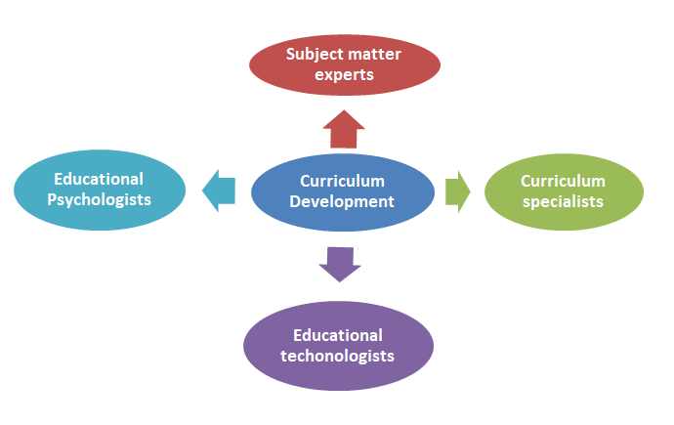

Slide 15
The principle of availability of time and other resources
Curriculum is the means to realize the outcomes of the educational objectives of the school. Implementation of the curriculum is equally important as curriculum construction. While developing curriculum experts should also keep its implementation in mind. They should be aware of the conditions of the schools and possible availability of time and resources available.

Slide 16
Please add there more principles

Slide 17
Thank you

