Slide 1
Behaviouristic and structural approach
Paper—6-i
Unit-III

Slide 2
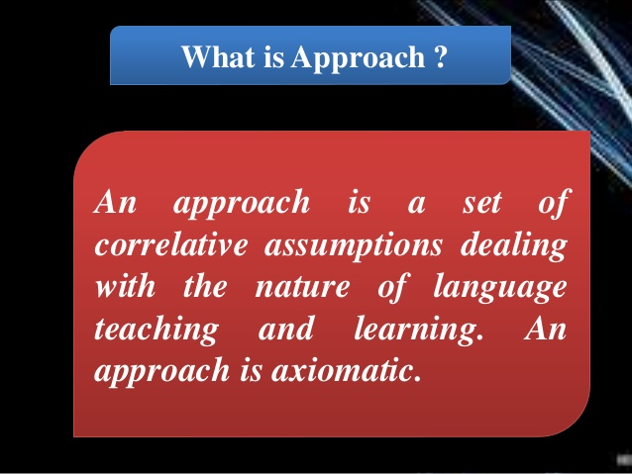

Slide 3
behavioristic approach
The behavioristic approach in teaching English emphasizes the importance of using positive reinforcement to encourage desired behaviors in learners. This approach is based on the principle that learning is an active process that is influenced by the environment and the consequences of actions.
In the behavioristic approach, the teacher sets clear goals and expectations for learners, and uses a variety of techniques such as repetition, feedback, and rewards to reinforce desired behaviors. For example, if a student correctly answers a question, the teacher may give them praise or a reward to reinforce that behavior and encourage the student to continue participating.

Slide 4
Another key aspect of the behavioristic approach is the use of drills and repetition to reinforce language patterns and vocabulary. This can include exercises like fill-in-the-blank or multiple-choice questions, where students practice using specific grammatical structures or vocabulary words in context.
The behavioristic approach can be effective in teaching English, especially for learners who are just beginning to acquire the language or who need a structured and predictable learning environment. However, some critics argue that this approach can be overly focused on memorization and may not promote the development of higher-level thinking skills or creativity in language use. Therefore, it is important for teachers to balance the use of behavioristic techniques with other approaches that foster critical thinking, communication, and creativity in language learning.

Slide 5
objectives
The behavioral approach in teaching English is an approach that focuses on observable behaviors, responses, and actions of learners. The primary objective of this approach is to teach English by using a system of reinforcement, feedback, and repetition. Here are some specific objectives of the behavioral approach in teaching English:
To develop the learner's ability to speak and write in English accurately and fluently.
To increase the learner's vocabulary by using repetition, rote learning, and memorization techniques.
To reinforce correct language usage and eliminate errors by providing immediate feedback.

Slide 6
To use positive reinforcement to encourage learners to use English correctly and accurately.
To provide learners with opportunities to practice and apply what they have learned in real-life situations.
To foster the development of the learner's confidence and self-esteem by providing positive feedback and encouragement.
To create a supportive and stimulating learning environment that motivates learners to learn and use English.

Slide 7
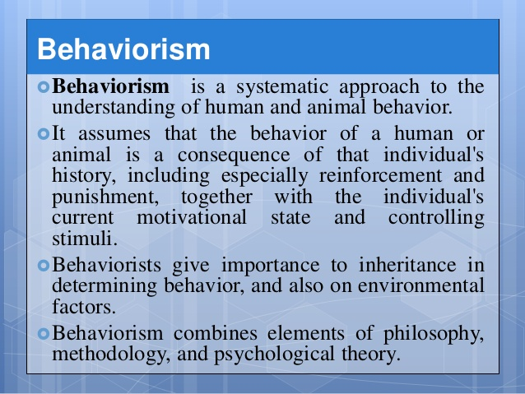

Slide 8
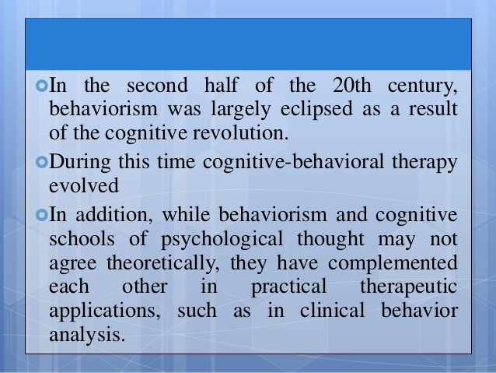

Slide 9
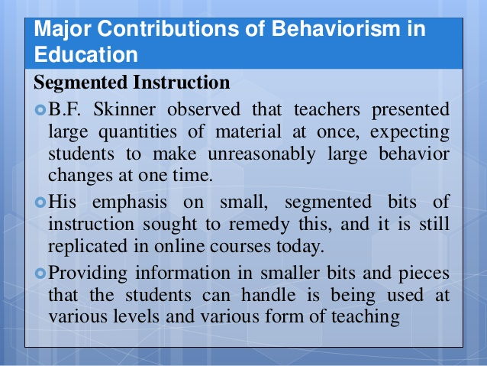

Slide 10


Slide 11
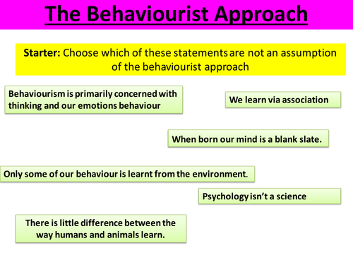

Slide 12
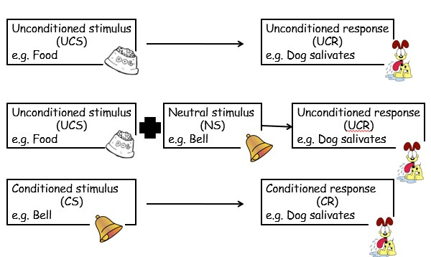

Slide 13
Principles
The behavioral approach in teaching English is based on several key principles that guide the design and implementation of instructional strategies. These principles include:
Reinforcement: This principle involves using positive reinforcement to encourage learners to use correct language and negative reinforcement to discourage incorrect language usage. The goal is to increase the frequency of desired language behaviors while reducing the frequency of undesired language behaviors.
Repetition: This principle emphasizes the importance of repeated exposure to language forms, structures, and vocabulary. The idea is that repeated practice will lead to automaticity, making it easier for learners to use the language correctly and fluently.

Slide 14
Shaping: This principle involves breaking down complex language skills into smaller, more manageable tasks. The goal is to build learners' skills gradually by starting with simple tasks and gradually increasing the complexity of the tasks.
Modeling: This principle involves providing learners with clear examples of correct language usage. The goal is to help learners develop accurate language models that they can emulate.

Slide 15
Feedback: This principle involves providing learners with immediate and specific feedback on their language usage. The feedback should be focused on both correct and incorrect language usage, with the goal of reinforcing correct usage and correcting errors.
Active participation: This principle emphasizes the importance of active participation in the learning process. Learners should be encouraged to engage in activities that require them to use the language actively and creatively.
Contextualization: This principle involves placing language learning in meaningful contexts. The goal is to help learners understand how the language is used in real-life situations and to develop the ability to use the language in contextually appropriate ways.

Slide 16
Structural Approach

Slide 17


Slide 18


Slide 19


Slide 20


Slide 21


Slide 22


Slide 23
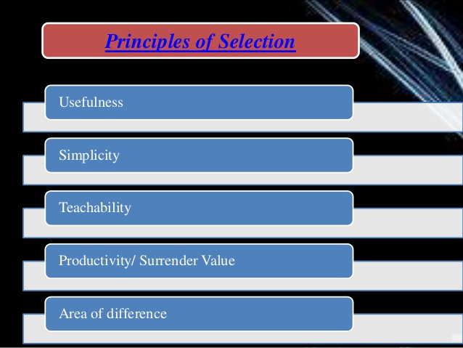

Slide 24


Slide 25
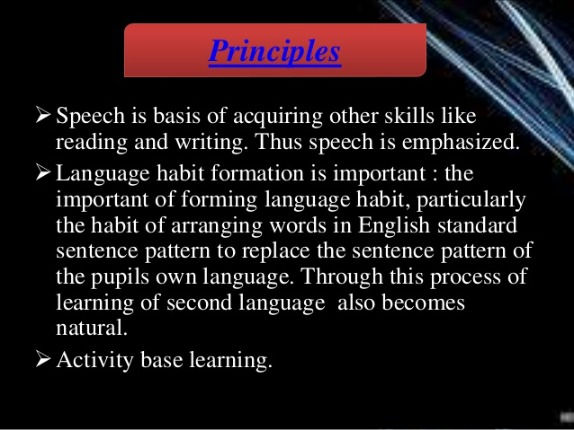

Slide 26
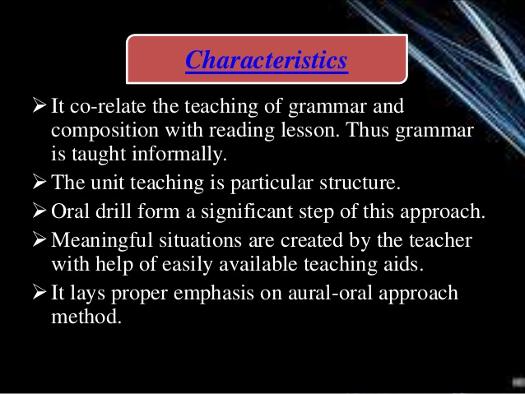

Slide 27


Slide 28


Slide 29


