Slide 1
Place Articulation
P-6-I
Unit-IV

Slide 2
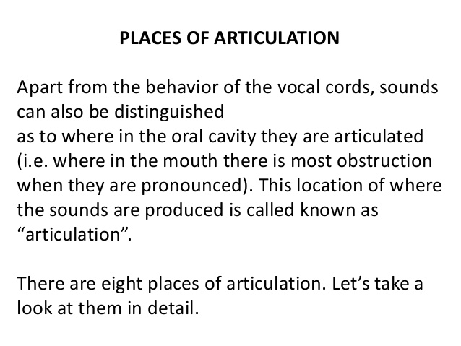

Slide 3
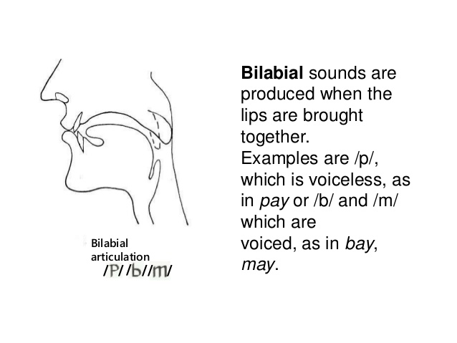

Slide 4
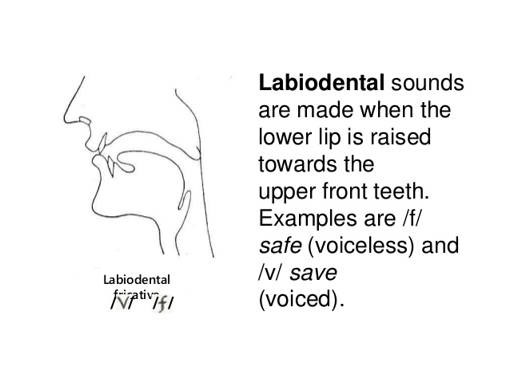

Slide 5
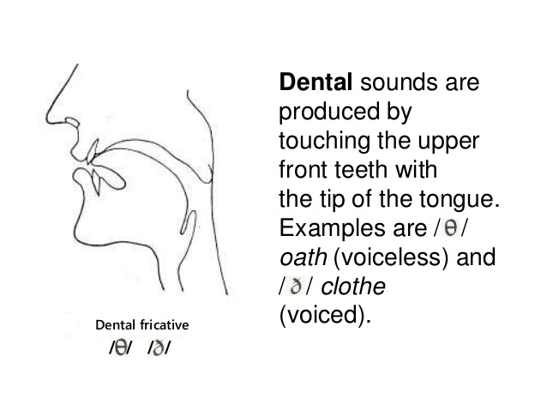

Slide 6
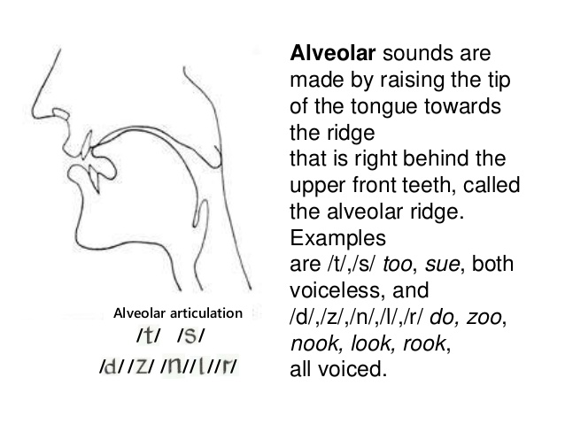

Slide 7
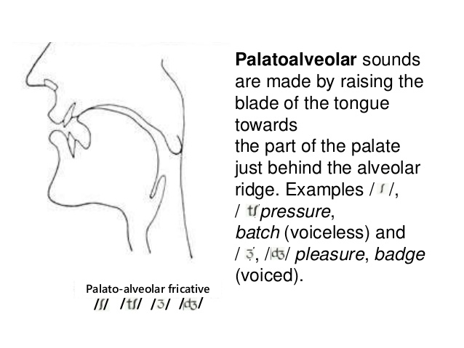

Slide 8
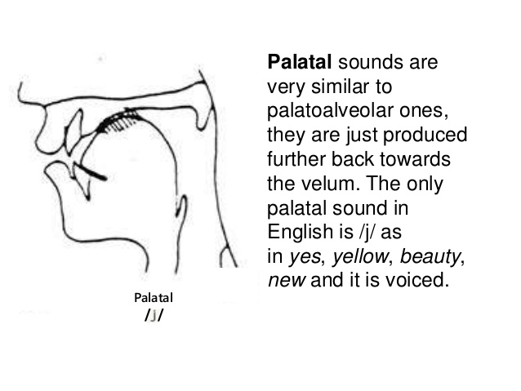

Slide 9
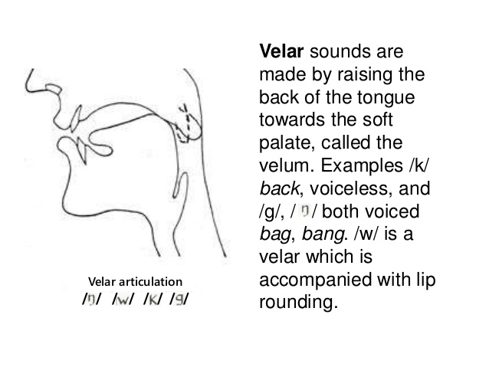

Slide 10
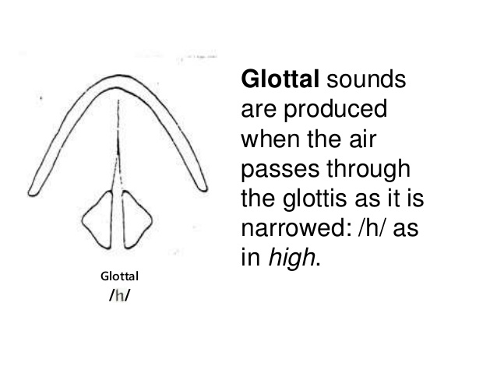

Slide 11
/p/ /b/
nature of articulation------ plosive
Place of articulation--------bi-labial
The air passage is completely blocked by closing the lips and by raising the soft plate.
When the lips are opened, the air rushes out and in doing so, makes an explosive sound.
The vocal cords do not vibrate for /p/ but vibrate for /b/

Slide 12
Thank you

