Slide 1
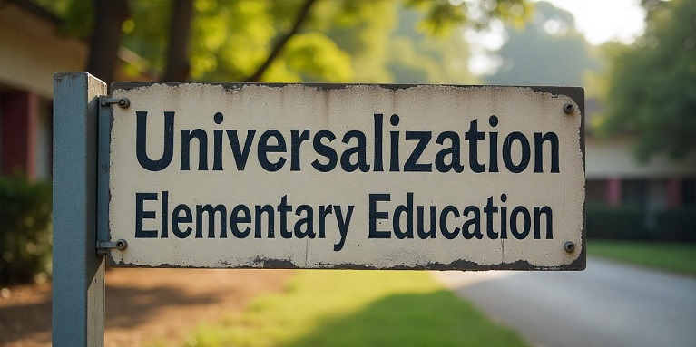
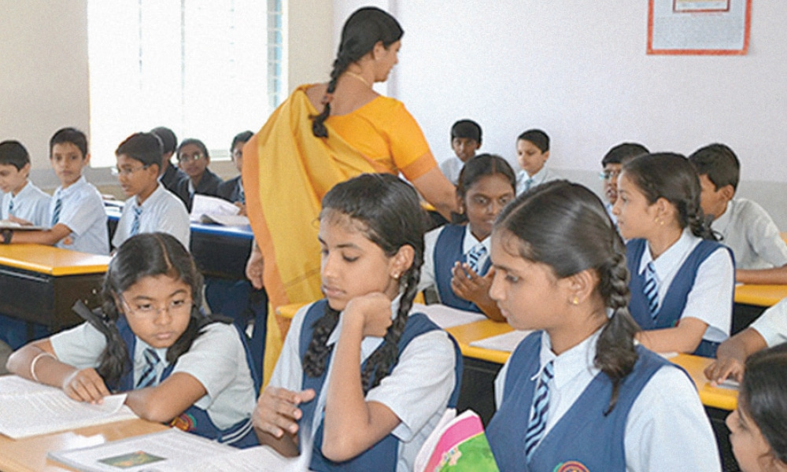
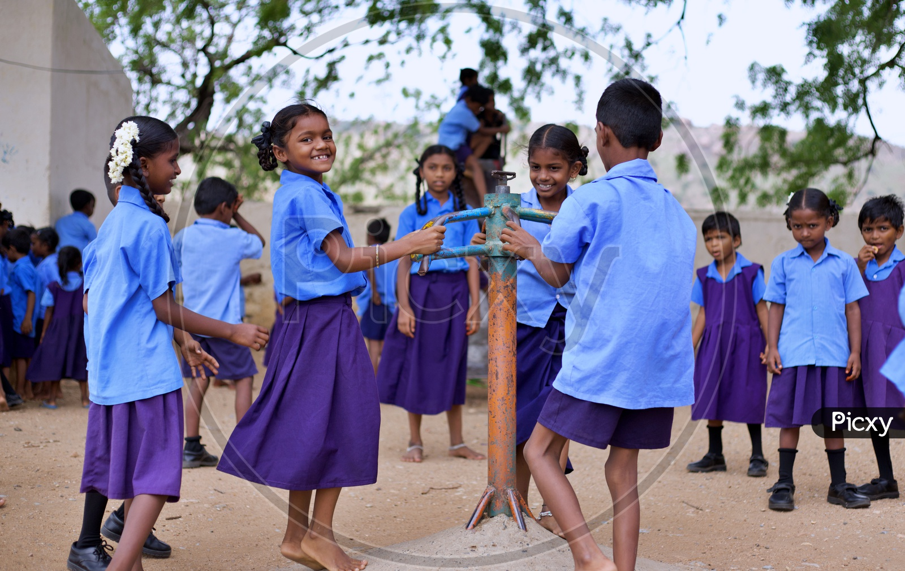

Slide 2
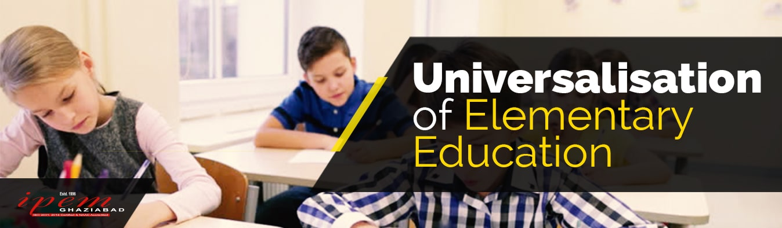
Universalization of elementary education refers to the provision of free, compulsory, and quality education to all children aged 6-14 years.
Typically from classes I-VIII.
Enroll all children in schools and ensure their retention until the completion of elementary education.
Bridge gender, regional, and social disparities in education.
Improve the quality of education to meet global standards.

Slide 3
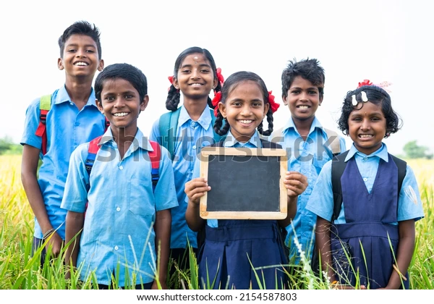
Major Goals of UEE are:
There are 3 major goals of UEE
Universalization of Provision: facilities should be provided to all the children (within accessible distances) between the age of 6 to 14 years.
Universalization of Enrollment: all children between the age of 6-14 years must be enrolled at elementary schools.
Universalization of Retention: A child joined at primary level must remain there until its completion, achieving a satisfactory level of quality education and a Minimum Level of Learning (MLL).

Slide 4
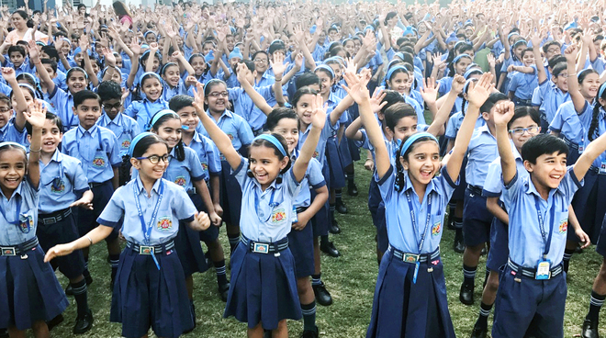
Significance/Importance of UEE
It is the birth right of the every
children to get the education.
To impart the knowledge of
reading, writing and solving
arithmetic problems.
To improve the Socio economic
condition of the people.
To make the young people
economically productive.
To reduce social discrimination
inequality and injustice.

Slide 5
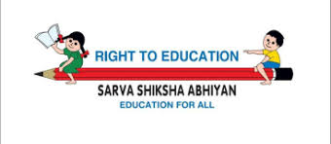
6. To overcome different social problems like early marriage, child labour, disparity in the education of boys and girls.
7. To make proper adjustment and progressive development with society.
8. Effective use of Human and Natural resources.
9. To make all people aware of their rights and duties.
10. To make aware about population Problems of the country.

Slide 6

Government Initiatives To Implement UEE:
The Constitution and Legal Framework:
Article 45 of the Directive Principles of State Policy originally mandated free and compulsory education for all children up to the age of 14.(DPSP-1950)
Article 21A, inserted by the 86th Amendment in 2002, made education a fundamental right for children aged 6-14 years, obligating the state to provide free and compulsory education.

Slide 7
The Right to Education Act (RTE) 2009:
This act was passed on August 4, 2009, and made free and compulsory education a fundamental right for children aged 6 to 14 in India under Article 21A of the Constitution.
The Act came into force on April 1, 2010
The Act includes provisions to ensure children from weaker and disadvantaged sections, including child laborers and those with disabilities, are not discriminated against and have access to quality education.
Standards of education should be maintained(like pupil-teacher ratios, infrastructure, and teacher qualifications etc.)
Prohibition of mental or physical harassment of students.

Slide 8
National Policy on Education (NPE)
In 1968 and revised in 1986 and 1992, played a crucial role in shaping India's approach to UEE.
The policy emphasized the need to promote quality education, remove social disparities, and ensure access to education for all, including marginalized groups.
The 1986 policy highlighted the need for a community-based approach and a focus on female literacy, especially in rural areas.

Slide 9
Operation Blackboard:
Operation Blackboard is a scheme undertaken by the Indian government in 1987
The scheme began under the Rajiv Gandhi government as part of the National Policy on Education (NPE) of 1986.
To improve primary education by providing minimum essential facilities and resources to schools, such as buildings, teachers, teaching materials, and separate sanitation facilities for girls, in line with the National Policy on Education (NPE) of 1986.
To ensure every primary school had at least two classrooms, two teachers, and a separate women's toilet.

Slide 10
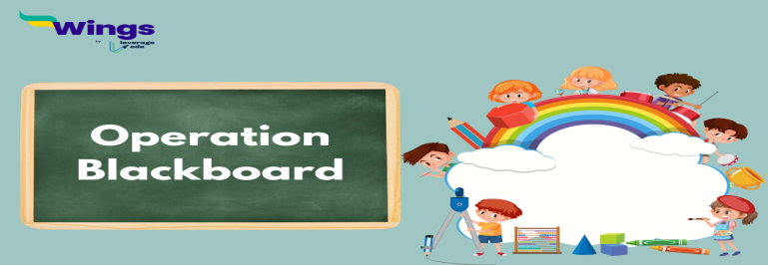
To provide necessary educational materials and teaching aids like charts, blackboard, tat pattis etc.
To foster the overall development of children by encouraging physical education and extracurricular activities.
To attract more children, especially girls, to primary schools, thereby increasing enrolment and retention.
To support the larger national goal of providing free and compulsory education to all children up to the age of 14 by 1995.

Slide 11
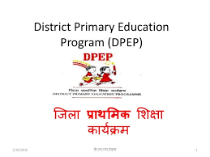
The District Primary Education Programme (DPEP):
A centrally sponsored scheme initiated
by MHRD launched in 1994.
focused on District-specific planning (Specially for backward districts).
Initially at 7 states and 42 districts covered under DPEP. (Assam, Haryana, Karnataka, Kerala, Madhya Pradesh, Maharashtra, and Tamil Nadu ).
Goal is to 100% enrollment and retention in elementary education.
Also to revitalize and universalize primary education in India by enhancing access, retention, and learning achievement, while also reducing disparities among different social groups

Slide 12
To address the issues of enrollment, retention, and quality of elementary education, particularly in backward districts.
It aimed to improve school infrastructure, teacher training, and community participation etc.
Ensuring children acquired basic literacy and numeracy skills

Slide 13
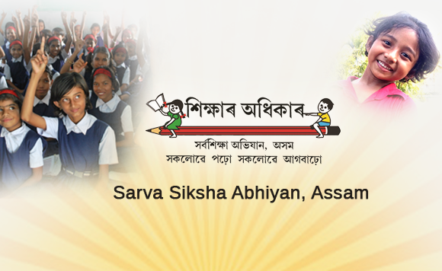

Slide 14

Sarva Shiksha Abhiyan (SSA):
National Flagship program Launched
in 2001 by the central Govt.
Joint effort between the Central Government, State Governments, and Local Self Governments.
The primary mission was to achieve universal elementary education in a time-bound manner, aiming to educate all children in the target age group by 2010.
SSA sought to provide quality elementary education to all children in the 6-14 age group.

Slide 15

Introduced innovative models like bridge courses for out-of-school children and learning enhancement programs to improve quality.
Provided financial assistance to states for the construction of schools, recruitment of teachers, and development of learning materials.
Special emphasis on the education of girls, children with disabilities, and children from disadvantaged communities.
The mission focused on a child-centric vision, offering quality education in regular schools.

Slide 16
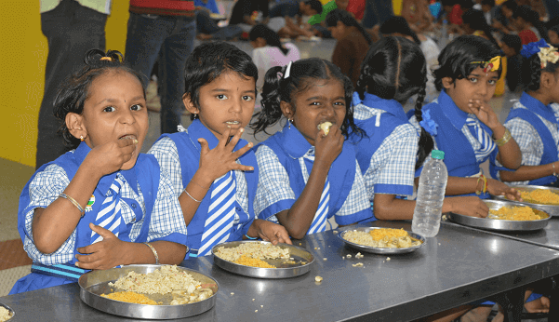
Mid-Day Meal Scheme:
Launched in 1995
The program was launched as the National Programme of Nutritional Support to Primary Education (NP-NSPE) in 1995.
It was extended to upper primary classes in 2008-09 and renamed the National Programme of Mid-Day Meal in Schools.
It was mandated by the Supreme Court of India in 2001 and aims to combat "classroom hunger" by offering a hot, nutritious meal, incentivizing parents to send their children to school.

Slide 17
The mid-day meal is now integrated into the Pradhan Mantri Poshan Shakti Nirman (PM POSHAN) initiative.
POSHAN: stands for Prime Minister's Overarching Scheme for Holistic Nourishment.
Scheme covers students in primary (Class I-V) and upper primary
(Class VI-VIII) classes.
The scheme is to promote school enrollment and retention.
To Reduce absenteeism and dropout rates.
To Improve the nutritional status of children from disadvantaged backgrounds.

Slide 18
Challenges in Universalizing Elementary Education:
High dropout rates.
Lack of quality education,
Gender and Social Disparities
Poor Learning Outcomes
Inadequate teaching methods
Lack of qualified and trained teachers.
Inadequate infrastructure and resources.
Insufficient allocation of funds.

Slide 19
CONCLUSION
India's universalization of elementary education has made progress, but challenges persist.
While enrollment is near-universal and gender parity has improved, learning outcomes remain poor, teacher shortages are significant, and dropout rates are high, particularly in rural areas.
Government initiatives like SSA and RTE have helped, but more efforts are needed to improve quality, address disparities, and reduce dropouts to achieve universal elementary education.

Slide 20


