Slide 1
Concept, Meaning and Definition of Psychology
B.Ed. 1st Sem
Paper code 204, Unit- I

Slide 2
Concept of psychology
Psychology is the scientific study of the mind and behavior, aiming to understand why people think, feel, and act the way they do. It encompasses everything from observable actions to internal mental processes like thoughts, emotions, and consciousness. The field uses scientific methods to investigate human and non-human behavior, exploring biological, social, and environmental factors that influence individuals and groups.

Slide 3
Concept of Psychology ( key aspects)
Scientific Study: Psychology employs systematic observation and experimentation to gather objective data and draw conclusions about the mind and behavior.
Mind and Behavior: The term "mind" refers to internal, subjective experiences such as thoughts, feelings, perception, and memory. "Behavior" includes all outward actions and reactions.

Slide 4
Diverse Areas: Psychology is a vast, multifaceted discipline with many specialized branches, including: Like
Clinical Psychology: Deals with the diagnosis, treatment, and prevention of mental disorders.

Slide 5
Cognitive Psychology: Focuses on mental processes like memory, problem-solving, and language.
Social Psychology: Examines how thoughts, feelings, and behaviors are influenced by others.
Developmental Psychology: Studies psychological growth and change throughout the lifespan.

Slide 6
Understanding the Individual:
Psychology seeks to understand both the universal patterns of behavior and the unique characteristics that make each person distinct.

Slide 7
Psychology
The word psychology is derived from two Greek words “psyche” means soul (Life) and logos means knowledge (explanation) or the study of soul.
The founders of psychology were both philosophers and psychologists and both tried to find answers to the philosophical questions in a scientific manner, like distinction between nature and nurture, existence of free will, etc.
In short, psychology is the science of behavior and mental processes.

Slide 8
DEFINING PSYCHOLOGY
In term of the study of soul:
Psychology was first defined as the study of the soul, since the word comes from the Greek words psyche (soul) and logos (study).

Slide 9
In terms of the study of the mind
People could not clearly answer questions like "What is soul?" or "How can it be studied?", so some Greek philosophers called psychology the study of the mind, but since "mind" raised the same doubts, this definition was also rejected.

Slide 10
In terms of the study of consciousness: Since soul and mind could not be clearly defined, philosophers and psychologists began to look for other suitable definitions.
William James in his book Principles of Psychology published in 1890 defined psychology as "the description and explanation of state of consciousness as such".
Wilhelm Wundt (1832-1920) who established the first psychology laboratory at the University of Leipzig, in Germany and his disciple Edward Bradford Titchener also defined psychology as the science of consciousness.
Some psychologists said psychology should study states of consciousness through introspection, or looking within, but this definition was also rejected.

Slide 11
It is too narrow because it does not include the subconscious and unconscious activities of the mind.
The introspection method was unscientific because it was completely subjective.
It did not include the study of animal consciousness.

Slide 12
In terms of the study of behavior: From the nineteenth century, psychology came to be defined as the study of behavior.
William McDougall, a British psychologist, was the first to define psychology as the science of behavior in his 1905 book Physiological Psychology.
Psychology may be best and most comprehensively defined as the positive science of the conduct of living creatures.

Slide 13
Later, in 1908, in his book Introduction to Social Psychology, he added the word "behavior to his definition and finally in 1949 in his book An Outline of Psychology gave the following meaningful definition.

Slide 14
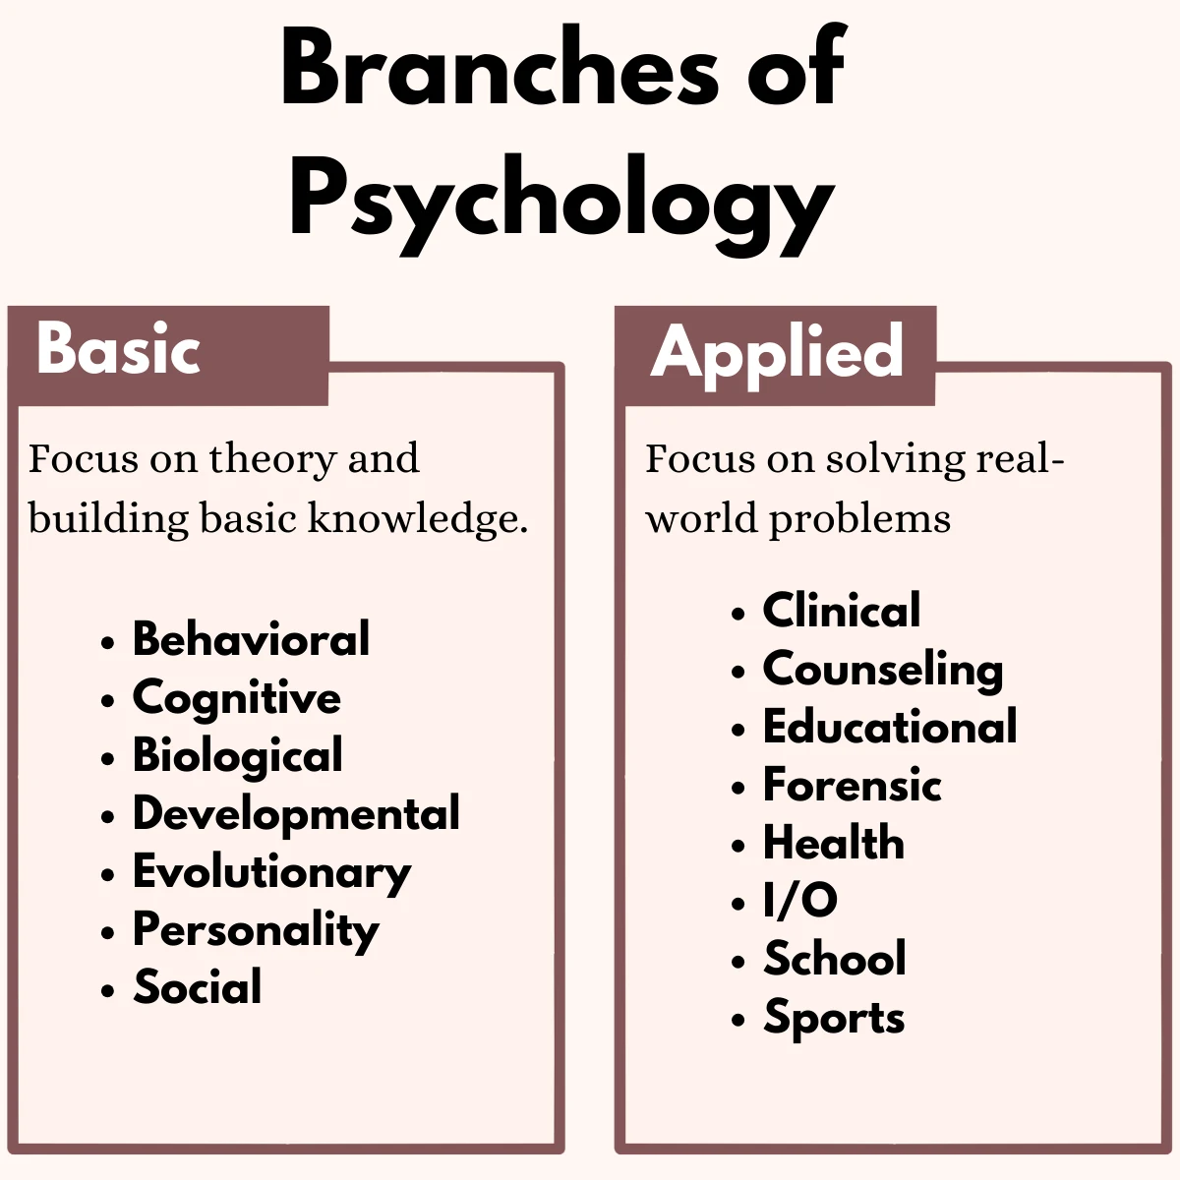

Slide 15
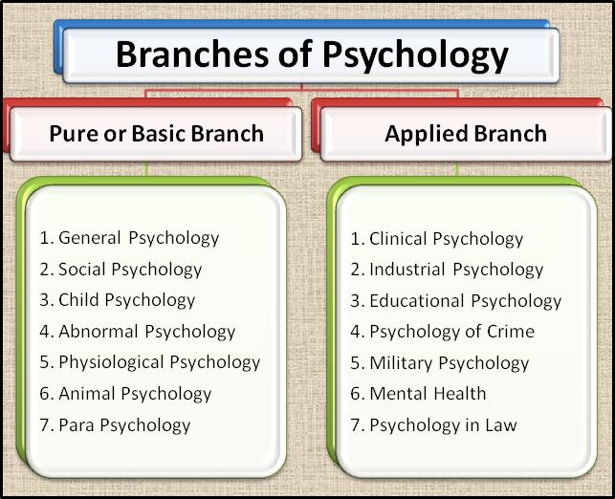

Slide 16
Abnormal Psychology
Abnormal psychology looks at psychopathology and abnormal behavior. It involves the study of people's emotional, thought, and behavior patterns to identify, understand, and potentially resolve any issues that may be negatively affecting a person's life.
psychological disorders, including anxiety and depression.

Slide 17
Behavioral Psychology
Behavioral psychology, also known as behaviorism, is a theory of learning based on the idea that all behaviors are acquired through conditioning. Behavioral strategies such as classical conditioning and operant conditioning are often utilized to teach or modify behaviors.
For example, a teacher might use a reward system to teach students to behave during class. When students are good, they receive gold stars, which can then be turned in for some sort of special privilege.

Slide 18
Biopsychology
Biopsychology is a psychological area focused on how the brain, neurons, and nervous system influence thoughts, feelings, and behaviors. The biopsychology field draws upon many different disciplines, including basic psychology, cognitive psychology, experimental psychology, biology, physiology, and neuroscience.
People who work in this type of psychology often study how brain injuries and brain diseases impact human behavior.

Slide 19
Clinical Psychology
Clinical psychology is the branch of psychology concerned with the assessment and treatment of mental illness, abnormal behavior, and psychiatric disorders. Clinicians often work in private practices, but many also work in community centers or at universities and colleges.
You can even find clinical psychology professionals in hospital settings and mental health clinics.

Slide 20
Cognitive Psychology
Cognitive psychology is a psychological area that focuses on internal mental states. This area has continued to grow since it emerged in the 1960s and is centered on the science of how people think, learn, and remember.
This type of psychology typically study cognitive functions such as perception, motivation, emotion, language, learning, memory, attention, decision-making, and problem-solving.

Slide 21
Comparative Psychology
Comparative psychology is the branch of psychology concerned with the study of animal behavior. This is important because the study of how animals behave can lead to a deeper and broader understanding of human psychology.

Slide 22
Counseling Psychology
Counseling psychology is one of the largest areas of psychology. It is centered on treating clients in mental distress who may be experiencing a wide variety of psychological symptoms.
The Society of Counseling Psychology explains that professionals working in this type of psychology can improve their clients' interpersonal functioning throughout life.² They do this by improving the client's social and emotional health, as well as addressing concerns about health, work, family, marriage, and more.

Slide 23
Cross-Cultural Psychology
Cross-cultural psychology is a branch of psychology that looks at how cultural factors influence human behavior. This may involve looking at differences between collective and individualist cultures, for instance. Cross-cultural psychologists might also look at how cultures vary in terms of emotion, personality, or child development

Slide 24
Developmental Psychology
Developmental psychology focuses on how people change and grow throughout life. This area of psychology seeks to understand and explain how and why people change. Developmental psychologists study physical growth, intellectual development, emotional changes, social growth, and perceptual changes that occur throughout the lifespan.
Some professionals may specialize in infant, child, adolescent, development, while others might primarily study the effects of developmental delays.

Slide 25
Educational Psychology
Educational psychology is the branch of psychology concerned with schools, teaching psychology, educational issues, and student concerns. Educational psychologists often study how students learn. They may also work directly with students, parents, teachers, and administrators to improve student outcomes.
Professionals in this type of psychology sometimes study how different variables influence individual students. They may also study learning disabilities, giftedness, and the instructional process.

Slide 26
Experimental Psychology
Experimental psychology is the psychological area that utilizes scientific methods to research the brain and behavior. Many of these techniques are also used in other psychology areas to study everything from childhood development to social issues.
correlational studies, case studies, and naturalistic observation.

Slide 27
Health Psychology
Health psychology (also sometimes called medical psychology or behavioral medicine) focuses on how biology, psychology, behavior, and social factors influence health and illness. This area of psychology involves the promotion of health across a wide variety of domains, as well as the prevention and treatment of disease and illness.

Slide 28
Industrial-Organizational Psychology
Industrial-organizational psychology applies psychological principles to workplace issues. This psychological area, often referred to as I/O psychology, seeks to improve productivity and efficiency in the workplace while maximizing the well-being of employees. It includes areas such as human factors.

Slide 29
Personality Psychology
Personality psychology is the branch of psychology that focuses on the study of thought patterns, feelings, and behaviors that make each individual unique. Classic theories of personality include Freud's psychoanalytic theory of personality and Erikson's theory of psychosocial development.

Slide 30
School Psychology
School psychology is a type of psychology that involves working in schools to help kids deal with academic, emotional, and social issues. School psychologists also collaborate with teachers, students, and parents to help create a healthy learning environment.

Slide 31
Social Psychology
Social psychology seeks to understand and explain social behavior. It looks at diverse topics including group behavior, social interactions and perceptions, leadership, nonverbal communication, and social influences on decision-making.

Slide 32
Sports Psychology
Sports psychology is the study of how psychology influences sports, athletic performance, exercise, and physical activity. Individuals may work with a sports psychologist to improve their focus, develop mental toughness, increase motivation, or reduce sports-related anxiety.

Slide 33
Thank You

