Slide 1


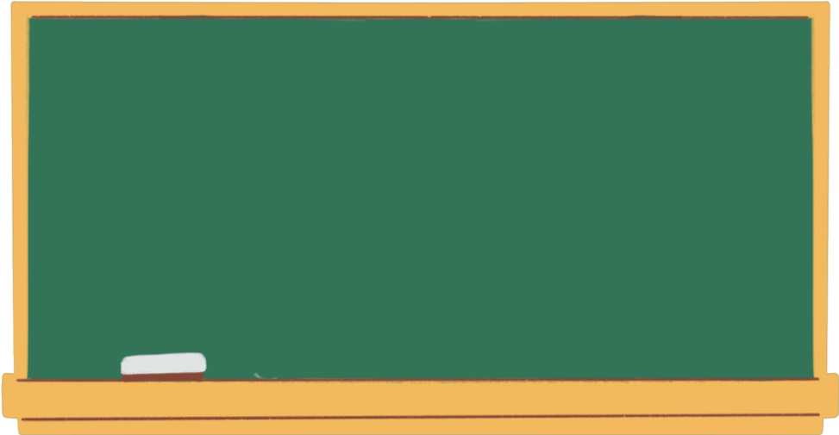

LANGUAGE - MEANING & FUNCTION
Presentation By
Khaleda Yasmin Mazumder.
Assistant Professor.
NAMCE.

Slide 2
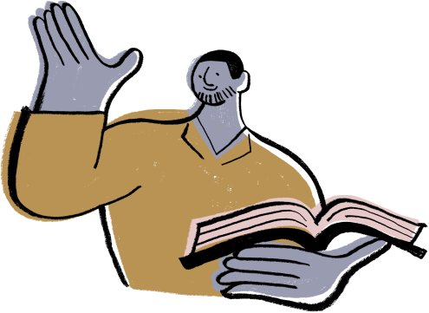
Meaning
Language is a structured system of communication.
A language is a system of communication which consists of a set of sounds and written symbols which are used by the people of a particular country or region for expressing or communicating.
Every community, just like every individual has its own language that expresses the ideas, values and attitudes of its members. It is by using language, we communicate our thoughts.

Slide 3
Meaning
Latin word- 'Lingua'-"tongue' i.e. Meaning of language is what is uttered with the help of tongue or mouth.
Language is a simple stream of sound that flows from the mouth of the speaker.

Slide 4


DEFINITION
Language is the speech sound produced by human beings to express their ideas, emotions, thoughts, desires & feelings (Aristotle).
Language is the institution whereby human beings communicate and interact by means of habitually used oral-auditory arbitrary symbols (Hall).

Slide 5


DEFINITION
Language are the principle communication system used by particular groups of human beings within the specific society of which they are members. (Lyon)
A language is a system of arbitrary sound symbols by means of which a social group interacts (Bloch and Trager).

Slide 6
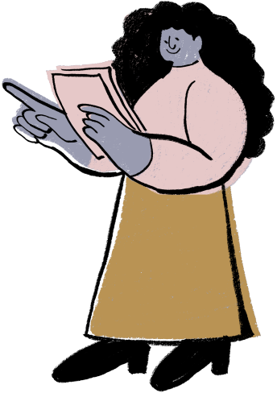



Functions of Language
Three basic Functions of language
Informative
Expressive
Directive

Slide 7
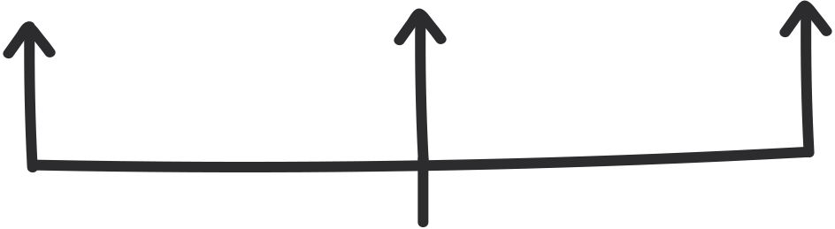

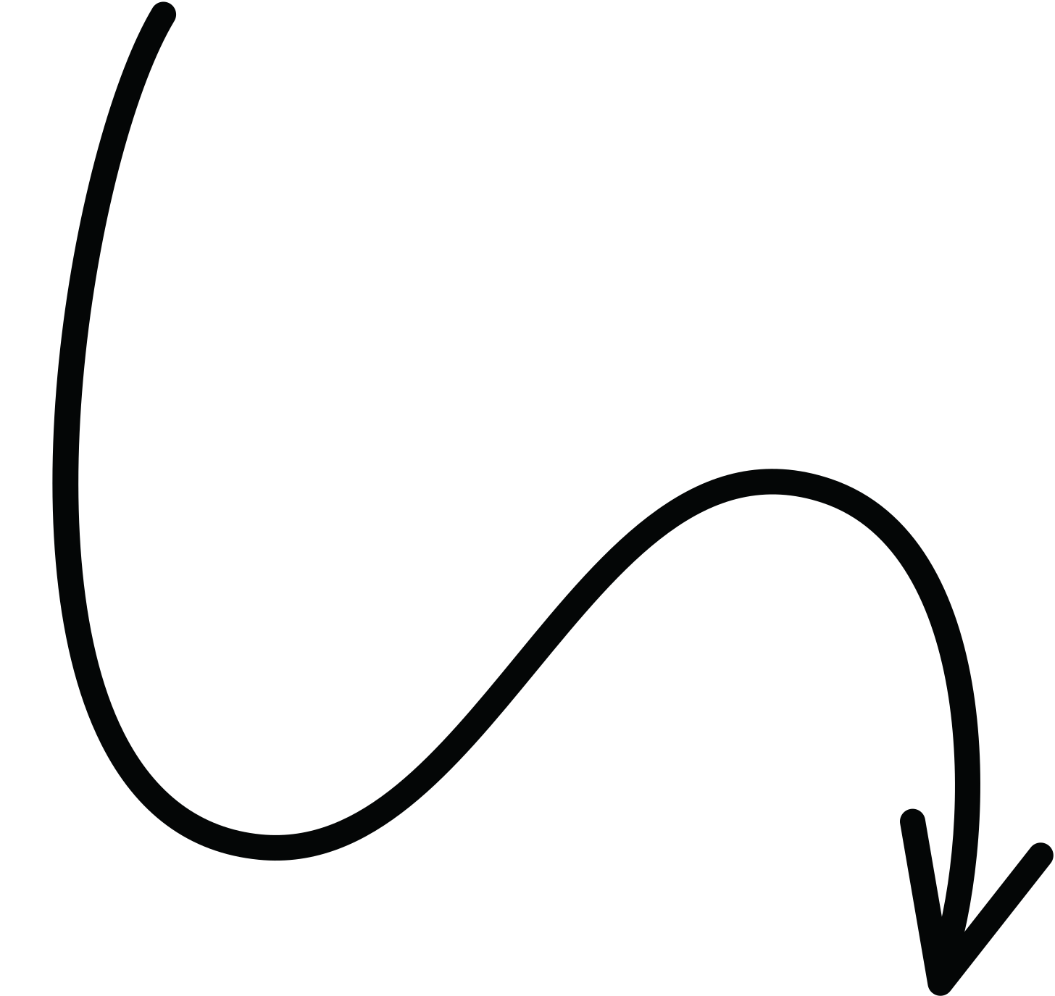
SAVIGNON (1983)
Functions of Language
Receptive Function
Expressive Function
Communicative Functions
Listening
Reading
Knowledge of Rules & Grammatical Forms
The ability to use the language
Speaking
Written

Slide 8











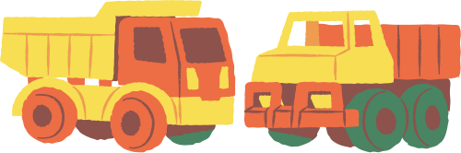

Roman Jakobson
The Referential Function
The Poetic Function
The Emotive (Expressive or Affective) Function
The Conative Function
The Phatic Function
The Meta-lingual (Meta - linguistic or Reflexive) Function.

Slide 9



Functions of Language in General
Means of Expression.
Express thoughts.
Basis for development.
Means to communicate.
Directive Function.
Social Function.

Slide 10




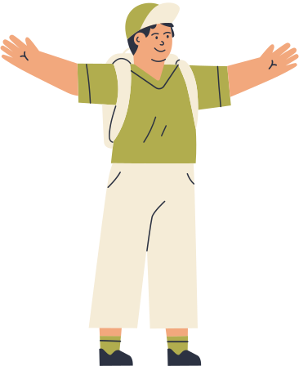
THANK YOU!

